Slide 1
Chapter 18
Air Pollution

Slide 2
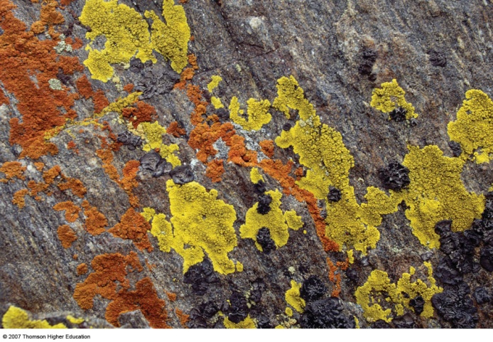
Core Case Study: When Is a Lichen Like a Canary?
Lichens can warn us of bad air because they absorb it as a source of nourishment.
Figure 19-1

Slide 3
18-1 What Is the Nature of the Atmosphere?
Concept 18-1 The atmosphere is structured in layers, including the troposphere, which supports life, and the stratosphere, which contains the protective ozone layer.

Slide 4
18-2 What Are the Major Outdoor Pollution Problems?
Concept 18-2 Pollutants mix in the air to form industrial smog, mostly the result of burning coal, and photochemical smog, caused by motor vehicle, industrial, and power plant emissions.

Slide 5
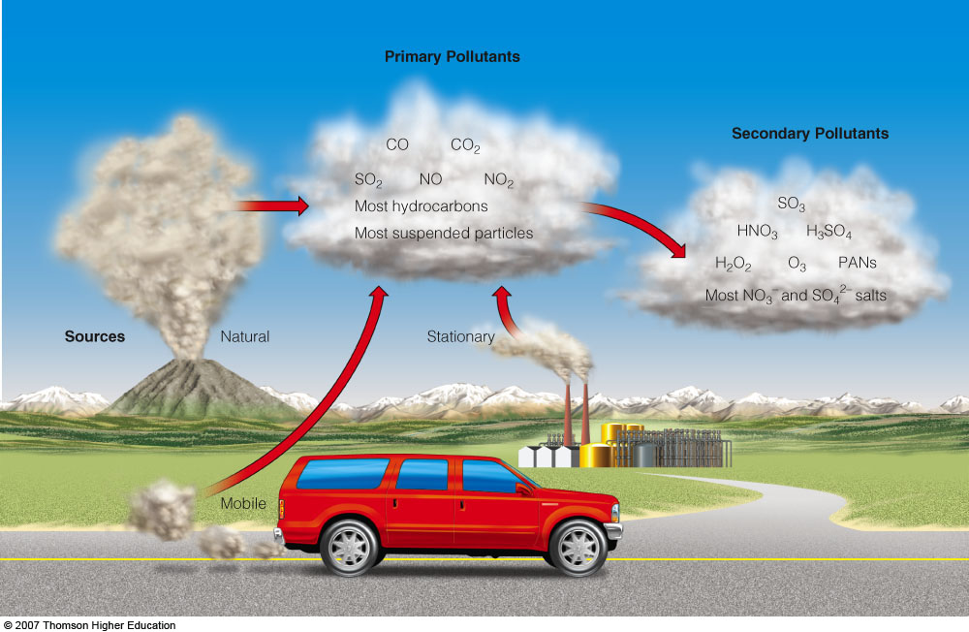
AIR POLLUTION
Some primary air pollutants may react with one another or with other chemicals in the air to form secondary air pollutants.
Figure 19-3

Slide 6
Major Air Pollutants
Carbon oxides
Nitrogen oxides and nitric acid
Sulfur dioxide (SO₂) and sulfuric acid
Suspended particulate matter (SPM)
Ozone (O₃)
Volatile organic compounds (VOCs)
Radon (Rn)

Slide 7
URBAN OUTDOOR AIR POLLUTION
Industrial smog is a mixture of sulfur dioxide, droplets of sulfuric acid, and a variety of suspended solid particles emitted mostly by burning coal.
In most developed countries where coal and heavy oil is burned, industrial smog is not a problem due to reasonably good pollution control or tall smokestacks that transfer the pollutant to rural areas.

Slide 8
Sunlight plus Cars Equals Photochemical Smog
Photochemical smog is a mixture of air pollutants formed by the reaction of nitrogen oxides and volatile organic hydrocarbons under the influence of sunlight.

Slide 9
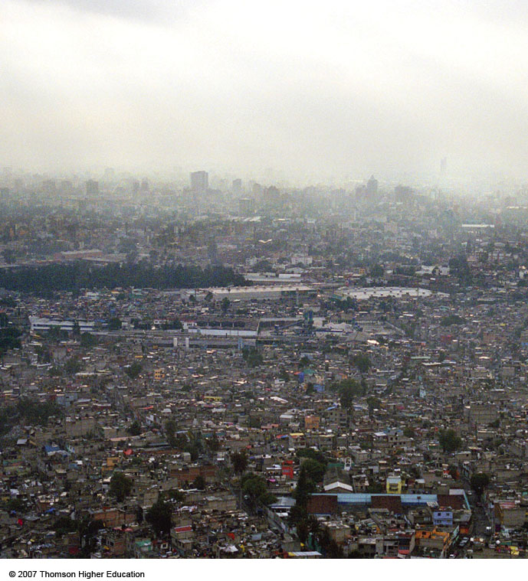
Sunlight plus Cars Equals Photochemical Smog
Mexico City is one of the many cities in sunny, warm, dry climates with many motor vehicles that suffer from photochemical smog.
Figure 19-4

Slide 10
18-3 What Is Acid Deposition and Why Is It a Problem?
Concept 18-3 Acid deposition is caused mainly by coal-burning power plant and motor vehicle emissions, and in some regions, threatens human health, aquatic life and ecosystems, forests, and human-built structures.

Slide 11
ACID DEPOSITION
Sulfur dioxides, nitrogen oxides, and particulates can react in the atmosphere to produce acidic chemicals that can travel long distances before returning to the earth’s surface.
Tall smokestacks reduce local air pollution but can increase regional air pollution.

Slide 12
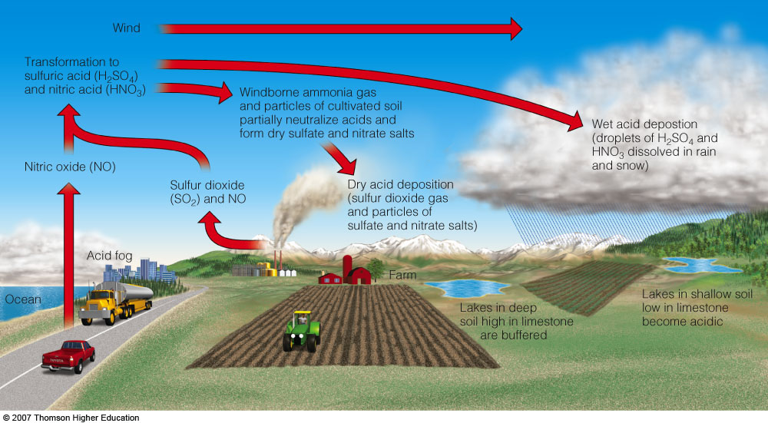
ACID DEPOSITION
Acid deposition consists of rain, snow, dust, or gas with a pH lower than 5.6.
Figure 19-6

Slide 13
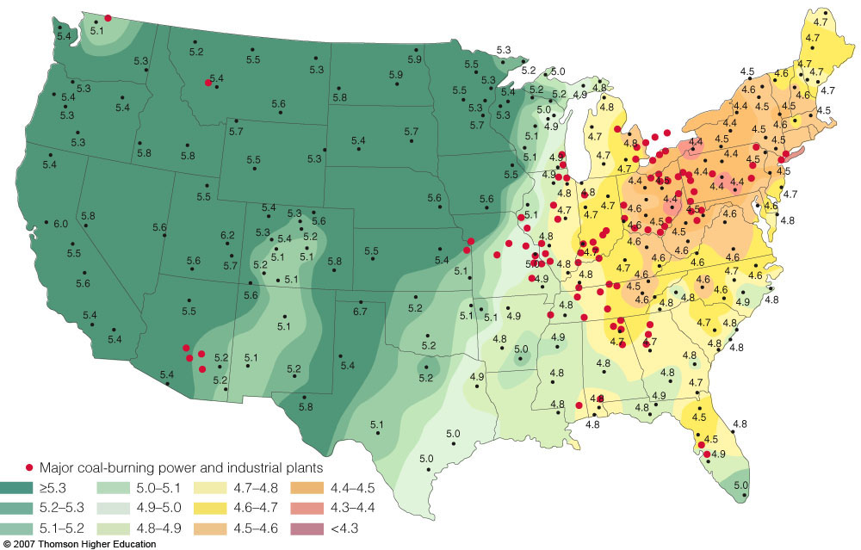
ACID DEPOSITION
pH measurements in relation to major coal-burning and industrial plants.
Figure 19-7

Slide 14
18-4 What Are the Major Indoor Air Pollution Problems?
Concept 18-4 The most threatening indoor air pollutants are smoke and soot from wood and coal cooking fires (a hazard found mostly in developing countries) and chemicals used in building materials and products.

Slide 15
INDOOR AIR POLLUTION
Indoor air pollution usually is a greater threat to human health than outdoor air pollution.
According to the EPA, the four most dangerous indoor air pollutants in developed countries are:
Tobacco smoke.
Formaldehyde.
Radioactive radon-222 gas.
Very small fine and ultrafine particles.

Slide 16
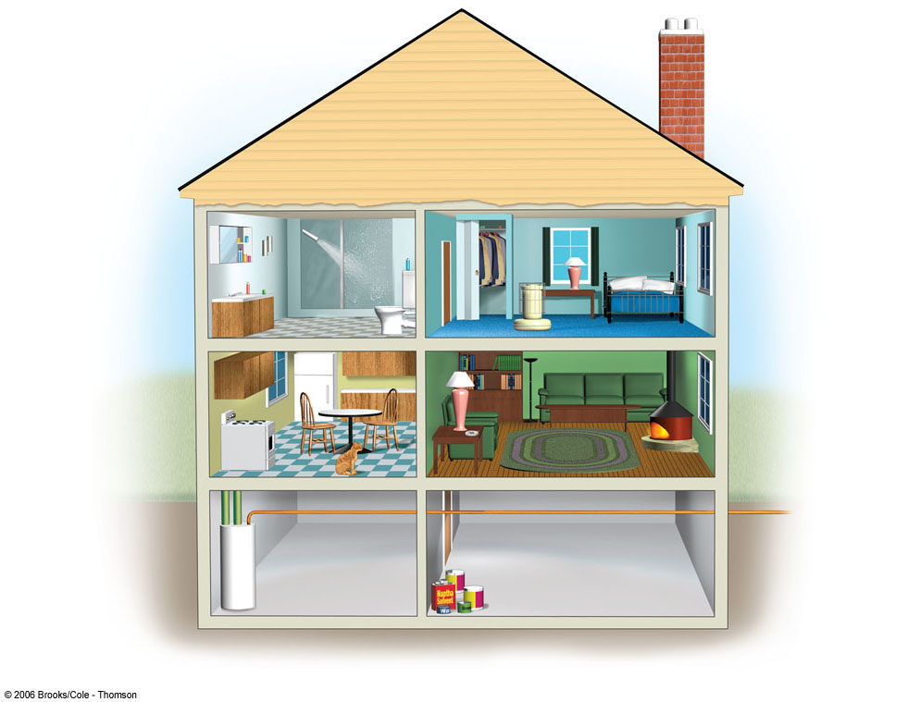
Para-dichlorobenzene
Chloroform
Tetrachloroethylene
Formaldehyde
1, 1, 1-
Trichloroethane
Styrene
Nitrogen Oxides
Benzo-α-pyrene
Particulates
Tobacco Smoke
Radon-222
Asbestos
Carbon Monoxide
Methylene Chloride
Fig. 19-11, p. 453

Slide 17
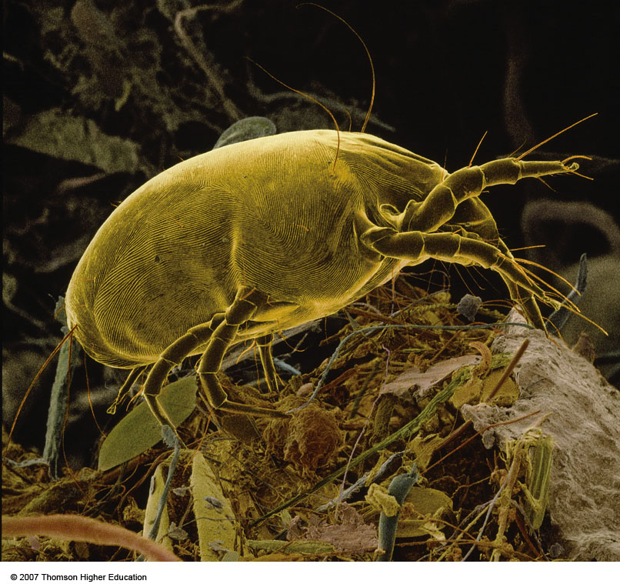
INDOOR AIR POLLUTION
Household dust mites that feed on human skin and dust, live in materials such as bedding and furniture fabrics.
Can cause asthma attacks and allergic reactions in some people.
Figure 19-12

Slide 18
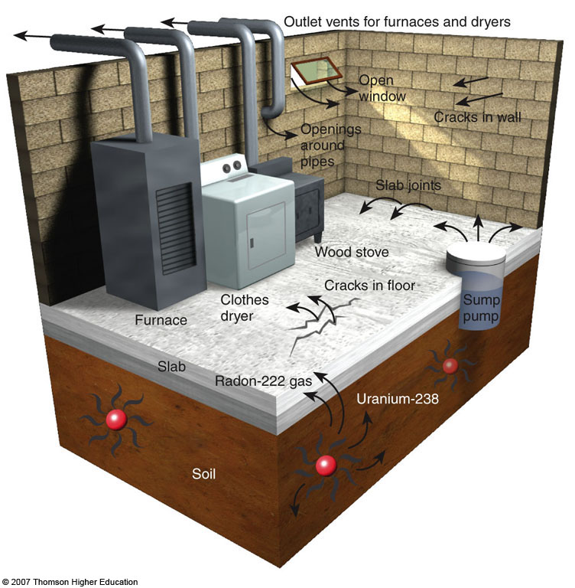
Case Study: Radioactive Radon
Radon-222, a radioactive gas found in some soils and rocks, can seep into some houses and increase the risk of lung cancer.
Sources and paths of entry for indoor radon-222 gas.
Figure 19-13

Slide 19
18-5 What Are the Health Effects of Air Pollution?
Concept 18-5 Air pollution can contribute to asthma, chronic bronchitis, emphysema, lung cancer, heart attack, and stroke.

Slide 20
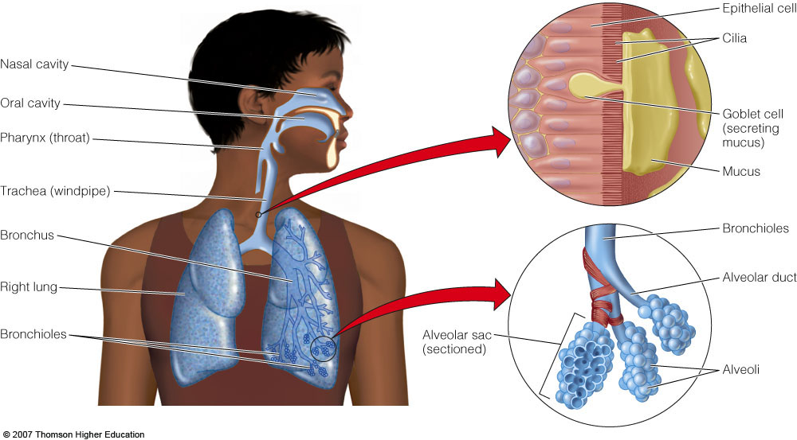
HEALTH EFFECTS OF AIR POLLUTION
Your respiratory system can help protect you from air pollution, but some air pollutants can overcome these defenses.
Figure 19-14

Slide 21
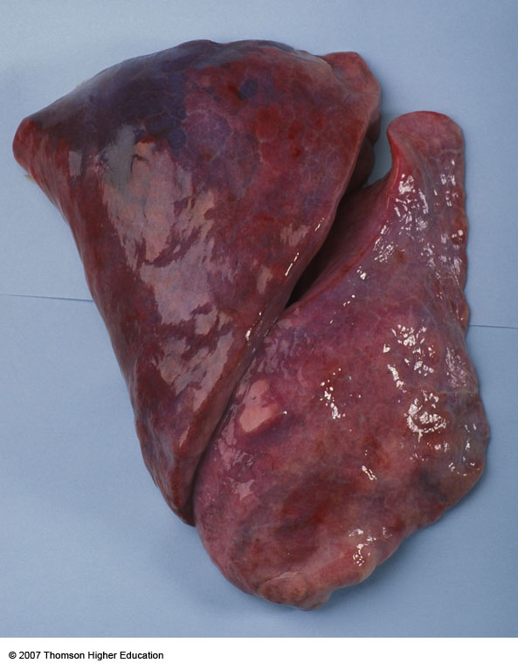
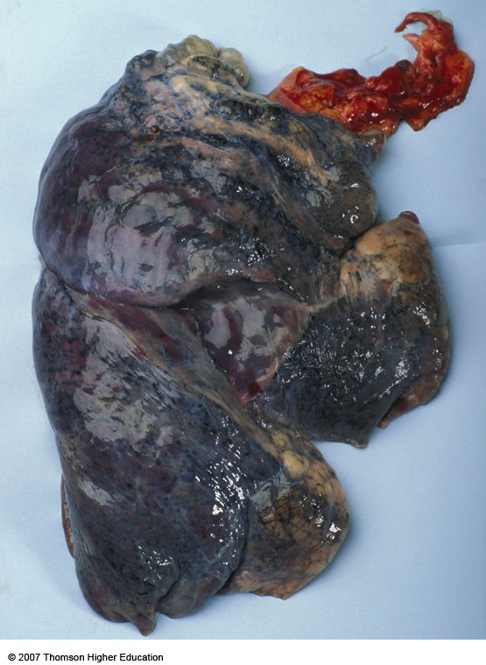
HEALTH EFFECTS OF AIR POLLUTION
Normal human lungs (left) and the lungs of a person who died of emphysema (right).
Figure 19-15

Slide 22
Air Pollution is a Big Killer
Each year, air pollution prematurely kills about 3 million people, mostly from indoor air pollution in developing countries.
In the U.S., the EPA estimates that annual deaths related to indoor and outdoor air pollution range from 150,000 to 350,000.
According to the EPA, each year more than 125,000 Americans get cancer from breathing diesel fumes.

Slide 23
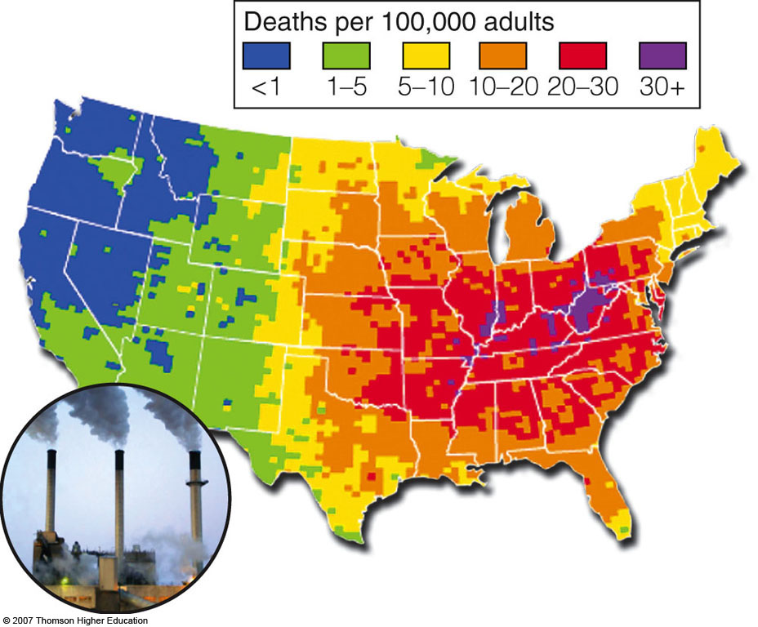
Air Pollution is a Big Killer
Spatial distribution of premature deaths from air pollution in the United States.
Figure 19-16

Slide 24
18-6 How Should We Deal with Air Pollution?
Concept 18-6 Legal, economic, and technological tools can help to clean up air pollution, but much greater emphasis should be focused on preventing air pollution.

Slide 25
PREVENTING AND REDUCING AIR POLLUTION
The Clean Air Acts in the United States have greatly reduced outdoor air pollution from several major pollutants:
Carbon monoxide
Nitrogen oxides
Sulfur dioxides
Suspended particulate matter

Slide 26
PREVENTING AND REDUCING AIR POLLUTION
Environmental scientists point out several deficiencies in the Clean Air Act:
The U.S. continues to rely on cleanup rather than prevention.
Airports are exempt from many air pollution regulations.
The Act does not regulate the greenhouse gas CO₂.
The Act has failed to deal seriously with indoor air pollution.

Slide 27
Solutions: Reducing Outdoor Air Pollution
There are a of ways to prevent and control air pollution from coal-burning facilities.
Electrostatic precipitator: are used to attract negatively charged particles in a smokestack into a collector.
Wet scrubber: fine mists of water vapor trap particulates and convert them to a sludge that is collected and disposed of usually in a landfill.

Slide 28
Solutions: Reducing Outdoor Air Pollution
There are a of ways to prevent and control air pollution from motor vehicles.
Because of the Clean Air Act, a new car today in the U.S. emits 75% less pollution than did pre-1970 cars.
There is an increase in motor vehicle use in developing countries and many have no pollution control devices and burn leaded gasoline.

Slide 29
Indoor Air Pollution
Little effort has been devoted to reducing indoor air pollution even though it poses a much greater threat to human health than outdoor air pollution.
Environmental and health scientists call for us to focus on preventing air pollution (especially indoor) in developing countries.

