Slide 1
Chapter 19
Climate Change and Ozone Depletion

Slide 2
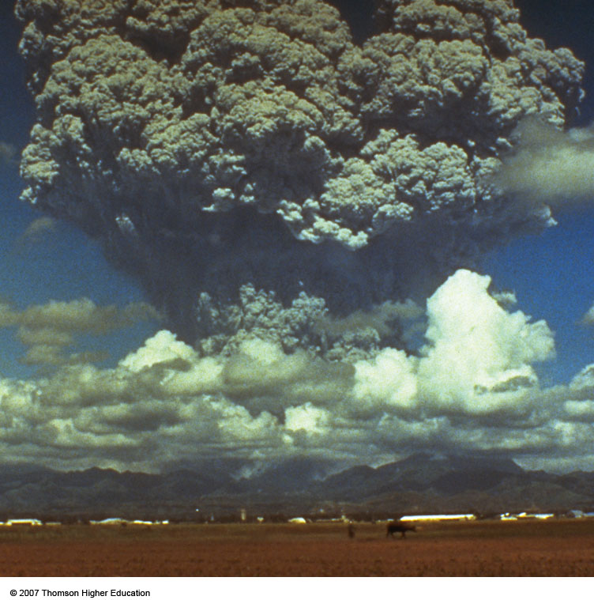
Core Case Study: Studying a Volcano to Understand Climate Change
NASA scientist correctly predicted that the 1991 Philippines explosion would cool the average temperature of the earth by 0.5Cº over a 15 month period and then return to normal by 1995.
Figure 20-1

Slide 3
19-1 How Might the Earth’s Temperature and Climate Change in the Future?
Concept 19-1 The overwhelming scientific consensus is that the earth’s atmosphere is warming rapidly, mostly because of human activities, and that this will lead to significant climate change during this century.

Slide 4
PAST CLIMATE AND THE GREENHOUSE EFFECT
Over the past 900,000 years, the troposphere has experienced prolonged periods of global cooling and global warming.
For the past 1,000 years, temperatures have remained fairly stable but began to rise during the last century.

Slide 5
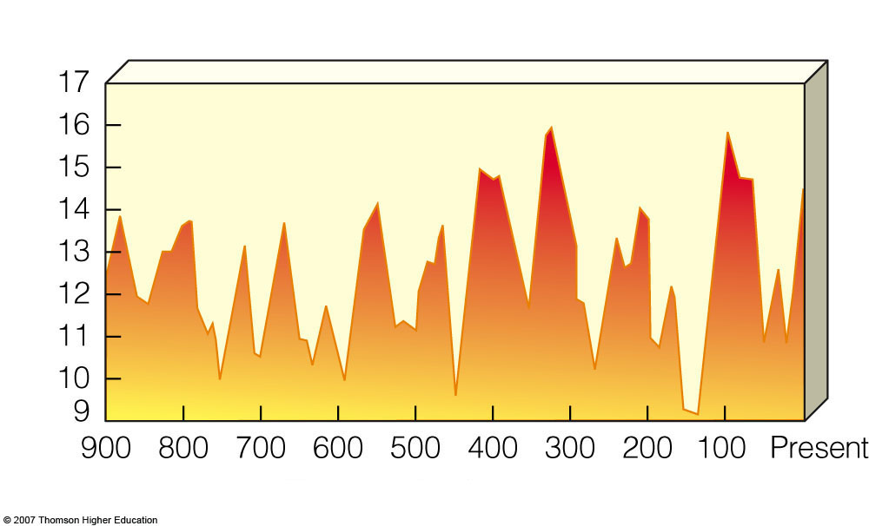
Average temperature over past 900,000 years
Average surface temperature (°C)
Thousands of years ago
Fig. 20-2a, p. 465
Notes:
Figure 20.2
Science: estimated changes in the average global temperature of the atmosphere near the earth’s surface over different periods of time. Although a particular place might have much lower or much higher readings than the troposphere’s average temperature, such averages provide a valuable way to measure long-term trends. QUESTION: What two conclusions can you draw from these diagrams? (Data from Goddard Institute for Space Studies, Intergovernmental Panel on Climate Change, National Academy of Sciences, National Aeronautics and Space Agency, National Center for Atmospheric Research, National Oceanic and Atmospheric Administration)

Slide 6
The Natural Greenhouse Effect
Three major factors shape the earth’s climate:
The sun.
Greenhouse effect that warms the earth’s lower troposphere and surface because of the presence of greenhouse gases.
Oceans store CO₂ and heat, evaporate and receive water
Natural cooling process through water vapor in the troposphere (heat rises).

Slide 7
Major Greenhouse Gases
The major greenhouse gases in the lower atmosphere are water vapor, carbon dioxide, methane, and nitrous oxide.
These gases have always been present in the earth’s troposphere in varying concentrations.
Fluctuations in these gases, plus changes in solar output are the major factors causing the changes in tropospheric temperature over the past 400,000 years.

Slide 8
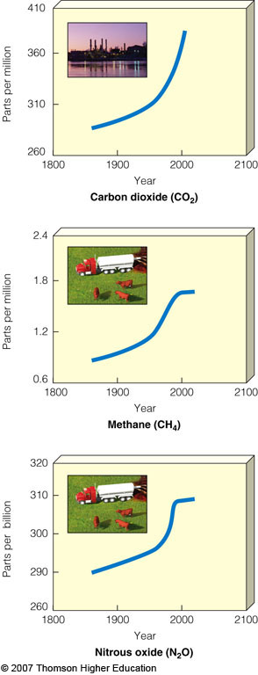
Major Greenhouse Gases
Increases in average concentrations of three greenhouse gases in the troposphere between 1860 and 2004, mostly due to fossil fuel burning, deforestation, and agriculture.
Figure 20-5

Slide 9
The Scientific Consensus about Future Climate Change
There is strong evidence that human activities will play an important role in changing the earth’s climate during this century.
Coupled General Circulation Models (CGCMs) couple, or combine, the effects of the atmosphere and the oceans on climate.

Slide 10
19-2 What Are Some Possible Effects of a Warmer Atmosphere?
Concept 19-2 The projected rapid change in the atmosphere's temperature during this century is very likely to increase drought and flooding, shift areas where food can be grown, raise sea levels, result in intense heat waves, and cause the premature extinction of many species.

Slide 11
Why Should We Be Concerned about a Warmer Earth?
A rapid increase in the temperature of the troposphere during this century would give us little time to deal with its harmful effects.
As a prevention strategy scientists urge to cut global CO₂ emissions in half over the next 50 years.
This could prevent changes in the earth’s climate system that would last for tens of thousands of years.

Slide 12
Effects of Higher CO₂ Levels on Photosynthesis
Increased CO₂ in the troposphere can increase plant photosynthesis (PS) but:
The increase in PS would slow as the plants reach maturity.
Carbon stored by the plants would be returned to the atmosphere as CO₂ when the plants die.
Increased PS decreases the amount of carbon stored in the soil.

Slide 13
EFFECTS OF GLOBAL WARMING
A warmer climate would have beneficial and harmful effects but poor nations in the tropics would suffer the most.
Some of the world’s floating ice and land-based glaciers are slowly melting and are helping warm the troposphere by reflecting less sunlight back into space.

Slide 14
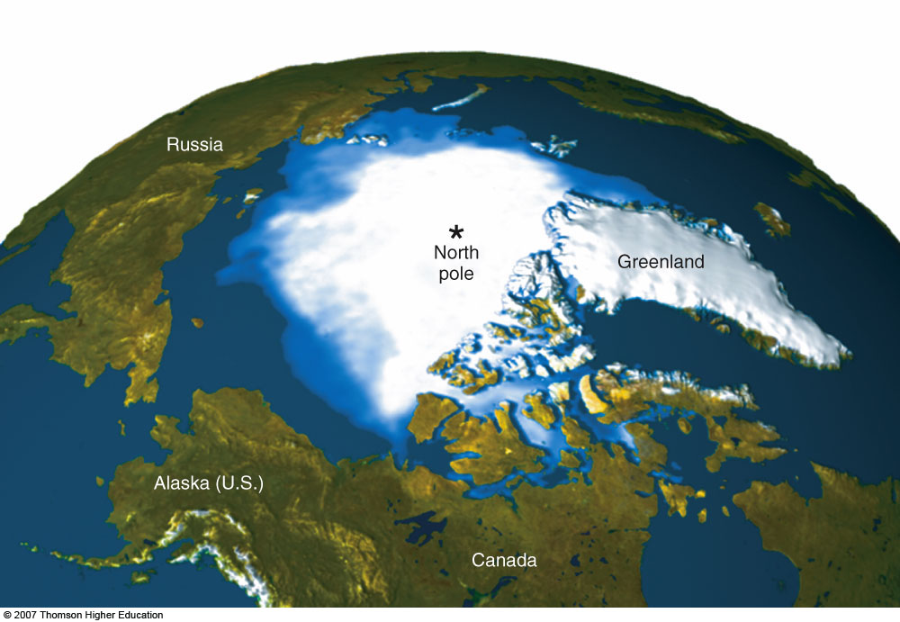
EFFECTS OF GLOBAL WARMING
Between 1979 and 2005, average Arctic sea ice dropped 20% (as shown in blue hues above).
Figure 20-8

Slide 15
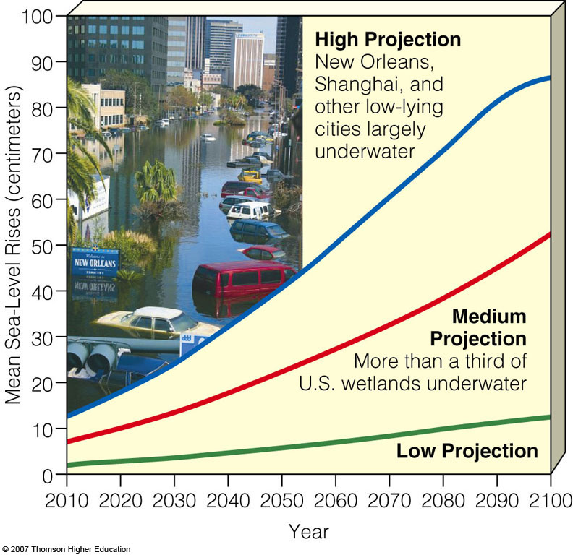
Rising Sea Levels
During this century rising seas levels are projected to flood low-lying urban areas, coastal estuaries, wetlands, coral reefs, and barrier islands and beaches.
Figure 20-10

Slide 16
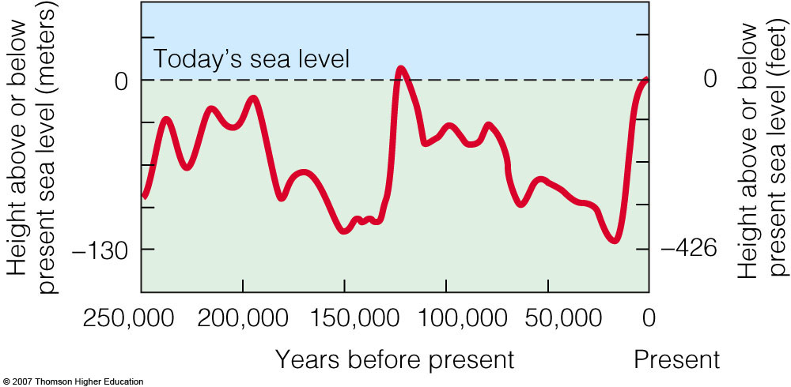
Rising Sea Levels
Changes in average sea level over the past 250,000 years based on data from ocean cores.
Figure 20-9

Slide 17
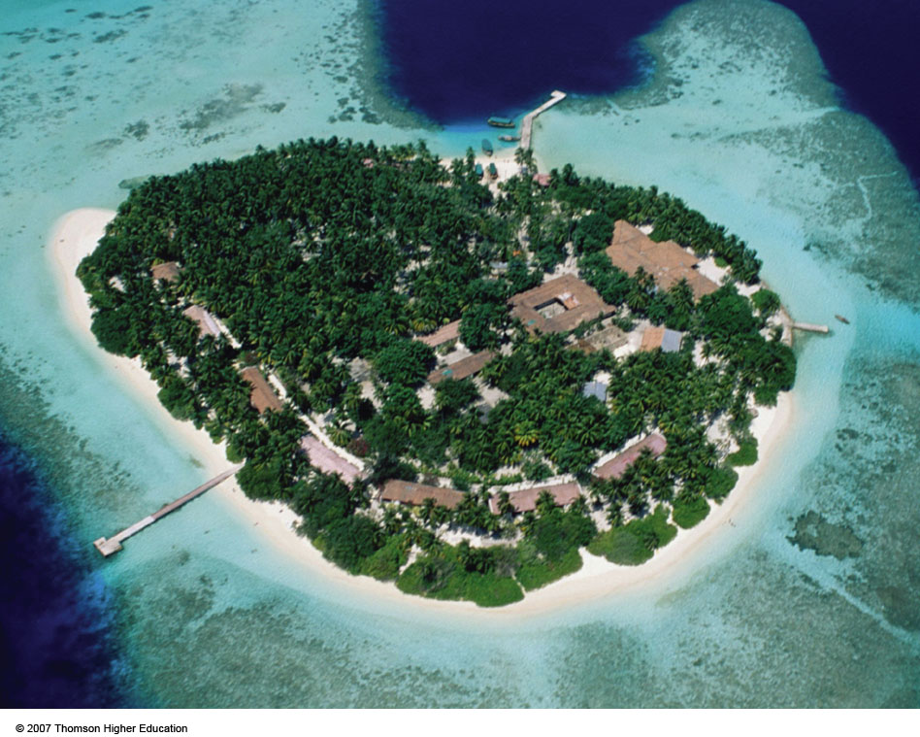
Rising Sea Levels
If seas levels rise by 9-88cm during this century, most of the Maldives islands and their coral reefs will be flooded.
Figure 20-11

Slide 18
EFFECTS OF GLOBAL WARMING
A warmer troposphere can decrease the ability of the ocean to remove and store CO₂ by decreasing the nutrient supply for phytoplankton and increasing the acidity of ocean water.
Global warming will lead to prolonged heat waves and droughts in some areas and prolonged heavy rains and increased flooding in other areas.

Slide 19
EFFECTS OF GLOBAL WARMING
In a warmer world, agricultural productivity may increase in some areas and decrease in others.
Crop and fish production in some areas could be reduced by rising sea levels that would flood river deltas.
Global warming will increase deaths from:
Heat and disruption of food supply.
Spread of tropical diseases to temperate regions.
Increase the number of environmental refugees.

Slide 20
19-3 What Can We Do to Slow Climate Change? (1)
Concept 19-3A To slow the rate of global warming and climate change, we can increase energy efficiency, sharply reduce greenhouse gas emissions, rely more on renewable energy resources, and slow population growth.

Slide 21
19-3 What Can We Do to Slow Climate Change? (2)
Concept 19-3B Governments can subsidize energy efficiency and renewable energy use, tax greenhouse gas emissions, set up cap-and-trade emission reduction systems, and help to slow population growth.

Slide 22
DEALING WITH GLOBAL WARMING
Two ways to deal with global warming:
Mitigation that reduces greenhouse gas emissions.
Adaptation, where we recognize that some warming is unavoidable and devise strategies to reduce its harmful effects.

Slide 23
Solutions: Reducing the Threat
We can improve energy efficiency, rely more on carbon-free renewable energy resources, and find ways to keep much of the CO₂ we produce out of the troposphere.

Slide 24
Actions by Some Countries, States, and Businesses
California has adopted a goal of reducing its greenhouse gas emission to 1990 levels by 2020, and 80% below by 2050.
Global companies (BP, IBM, Toyota) have established targets to reduce their greenhouse emissions 10-65% to 1990 levels by 2010.

Slide 25
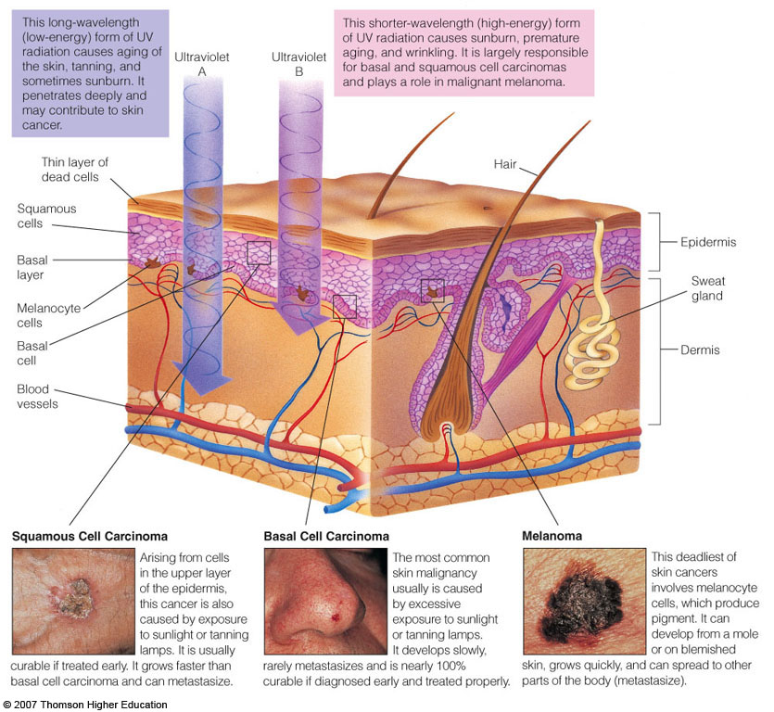
Case Study: Skin Cancer
Structure of the human skin and relationship between radiation and skin cancer.
Figure 20-22

Slide 26
19-4 How Have We Depleted O₃ in the Stratosphere and What Can We Do?
Concept 19-4A Widespread use of certain chemicals has reduced ozone levels in the stratosphere, which allows for more harmful ultraviolet radiation to reach the earth’s surface.
Concept 19-4B To reverse ozone depletion, we must stop producing ozone-depleting chemicals and adhere to the international treaties that ban such chemicals.

