Slide 1
Chapter 3
Ecosystems: What Are They and How Do They Work?

Slide 2
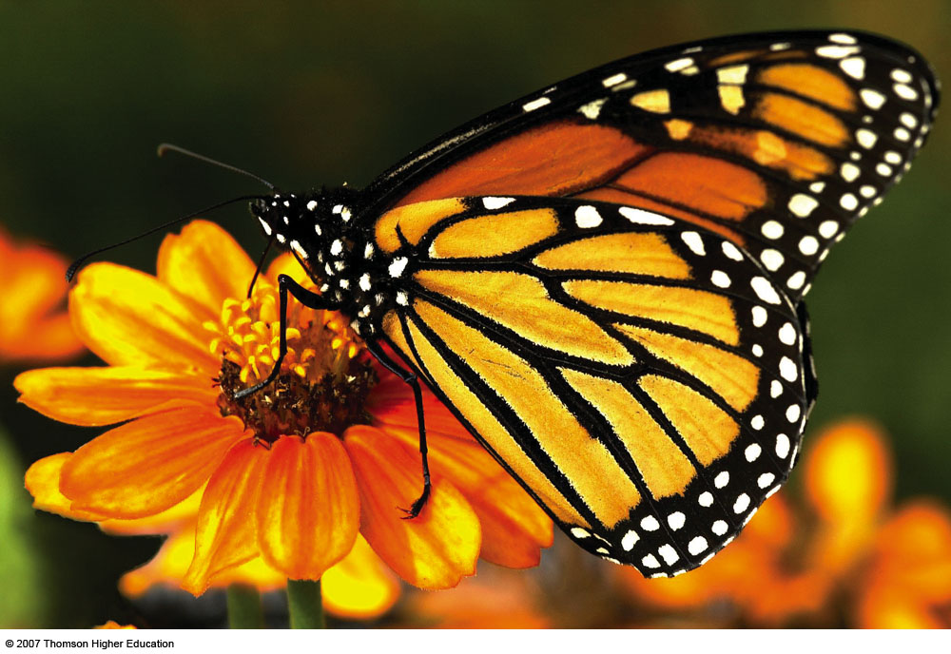
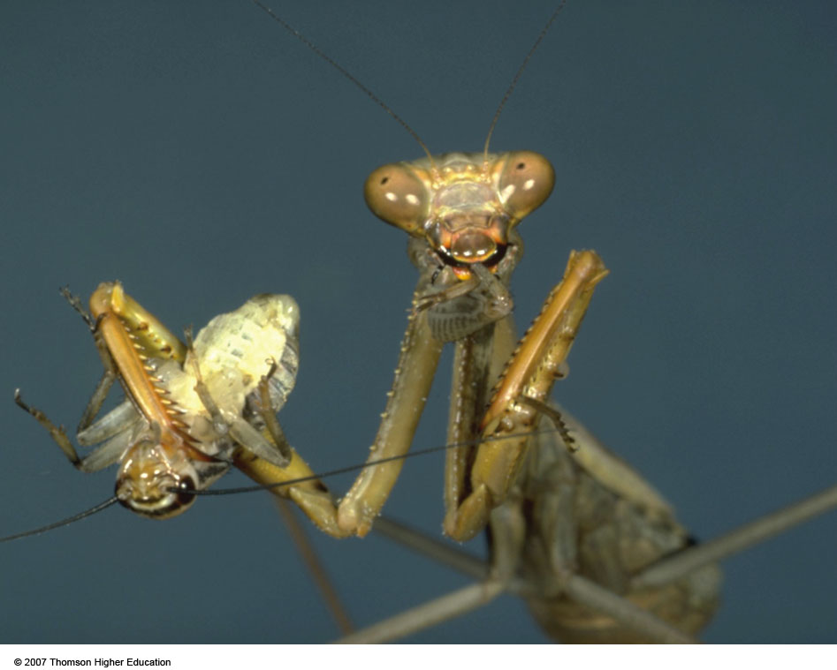
Core Case Study: Have You Thanked the Insects Today?
Many plant species depend on insects for pollination.
Insect can control other pest insects by eating them
Figure 3-1

Slide 3
3-1 What Is Ecology?
Concept 3-1 Ecology is the study of how organisms interact with one another and with their physical environment of matter and energy.

Slide 4
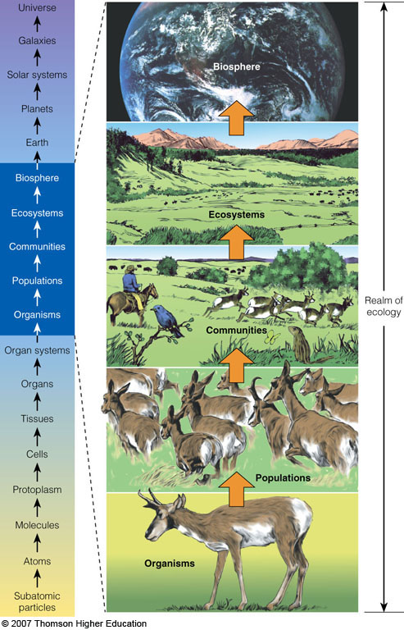
THE NATURE OF ECOLOGY
Ecology is a study of connections in nature.
How organisms interact with one another and with their nonliving environment.
Figure 3-2

Slide 5
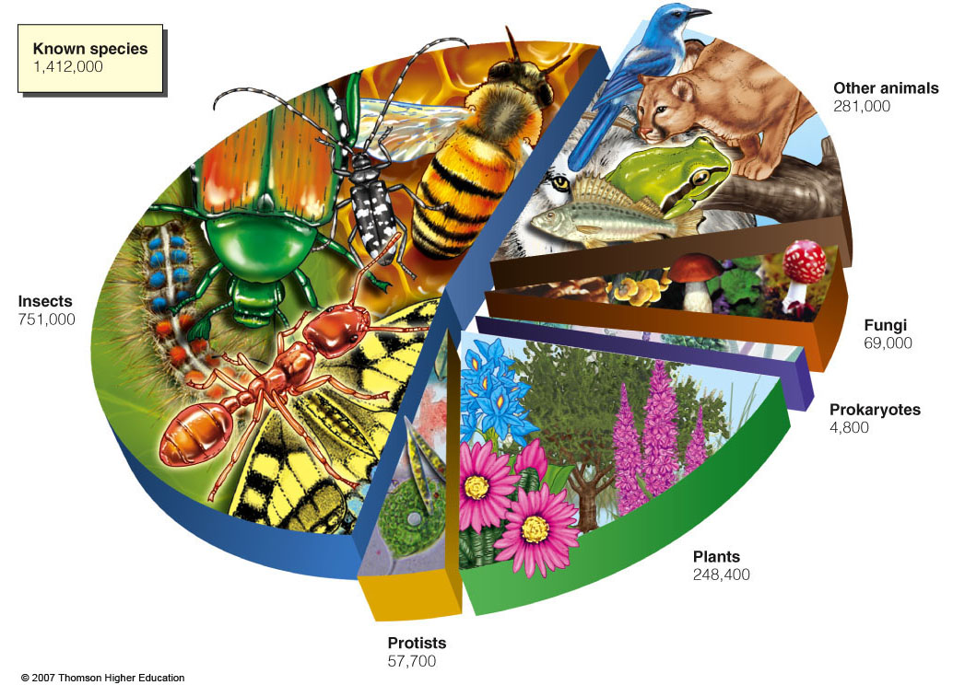
Organisms and Species
Organisms, the different forms of life on earth, can be classified into different species based on certain characteristics.
Figure 3-3

Slide 6
Case Study: Which Species Run the World?
Multitudes of tiny microbes such as bacteria, protozoa, fungi, and yeast help keep us alive.
Harmful microbes are the minority.
Soil bacteria convert nitrogen gas to a usable form for plants.
They help produce foods (bread, cheese, yogurt, beer, wine).
90% of all living mass.
Helps purify water, provide oxygen, breakdown waste.
Lives beneficially in your body (intestines, nose).

Slide 7
Populations, Communities, and Ecosystems
Members of a species interact in groups called populations.
Populations of different species living and interacting in an area form a community.
A community interacting with its physical environment of matter and energy is an ecosystem.

Slide 8
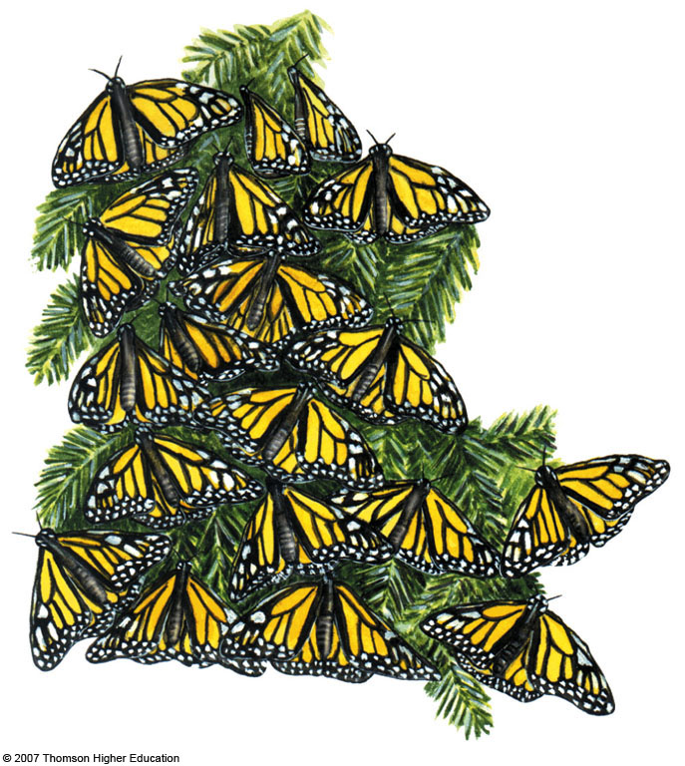
Populations
A population is a group of interacting individuals of the same species occupying a specific area.
The space an individual or population normally occupies is its habitat.
Figure 3-4

Slide 9
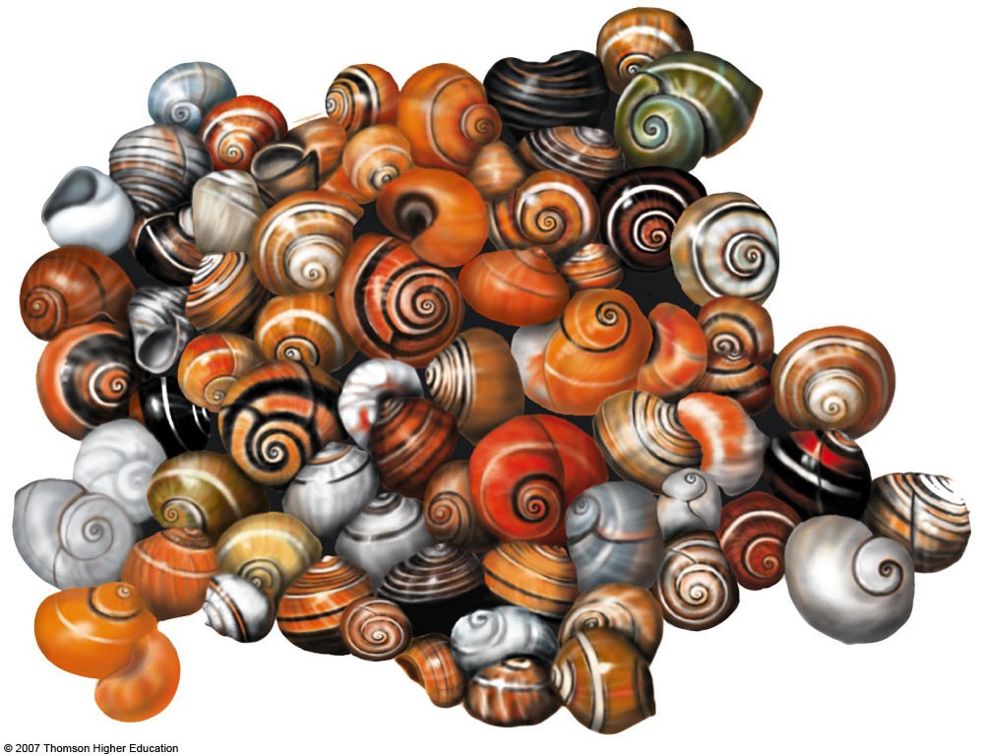
Populations
Genetic diversity
In most natural populations individuals vary slightly in their genetic makeup.
Figure 3-5

Slide 10
3-2 What Keeps Us and Other Organisms Alive?
Concept 3-2 Life is sustained by the flow of energy from the sun through the biosphere, the cycling of nutrients within the biosphere, and gravity.

Slide 11
Biosphere
Atmosphere
Membrane of air around the planet.
Stratosphere
Lower portion contains ozone to filter out most of the sun’s harmful UV radiation.
Hydrosphere
All the earth’s water: liquid, ice, water vapor
Lithosphere
The earth’s crust and upper mantle.

Slide 12
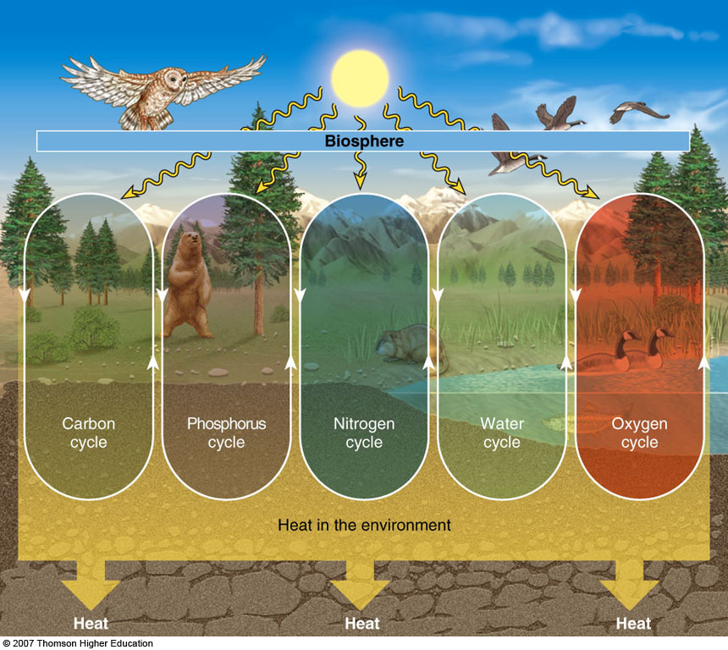
What Sustains Life on Earth?
Solar energy, the cycling of matter, and gravity sustain the earth’s life.
Figure 3-7

Slide 13
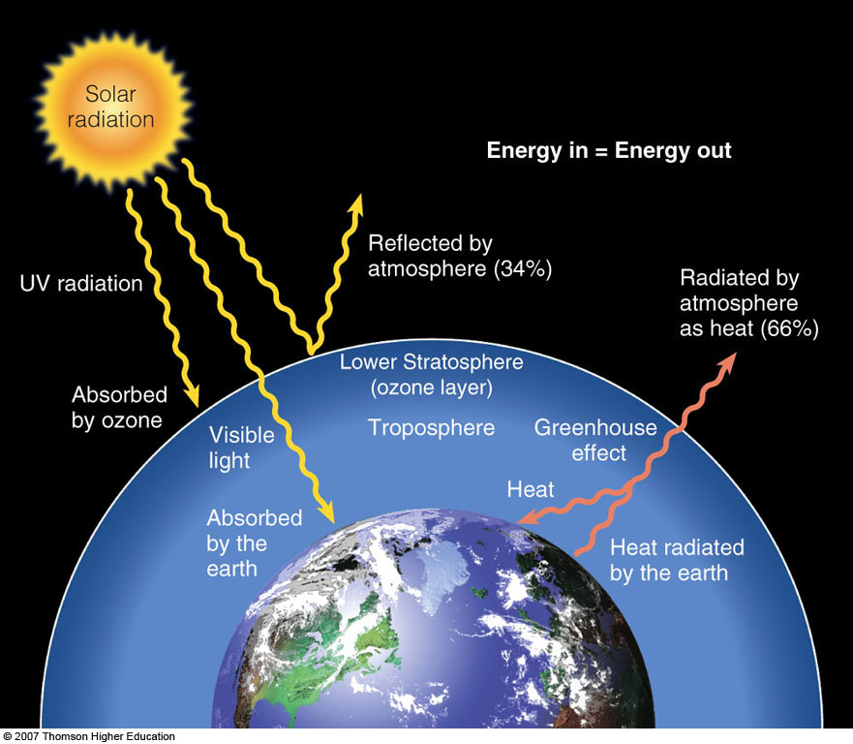
What Happens to Solar Energy Reaching the Earth?
Solar energy flowing through the biosphere warms the atmosphere, evaporates and recycles water, generates winds and supports plant growth.
Figure 3-8

Slide 14
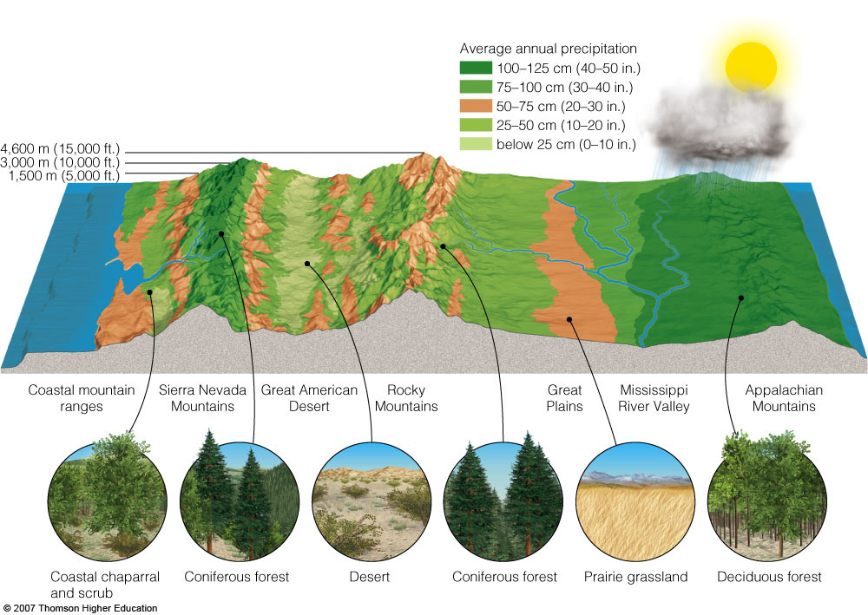
ECOSYSTEM COMPONENTS
Life exists on land systems called biomes and in freshwater and ocean aquatic life zones.
Figure 3-9

Slide 15
3-3 What Are the Major Components of an Ecosystem?
Concept 3-3A Ecosystems contain living (biotic) and nonliving (abiotic) components.
Concept 3-3B Some organisms produce the nutrients they need, others get their nutrients by consuming other organisms, and some recycle nutrients back to producers by decomposing the wastes and remains of organisms.

Slide 16
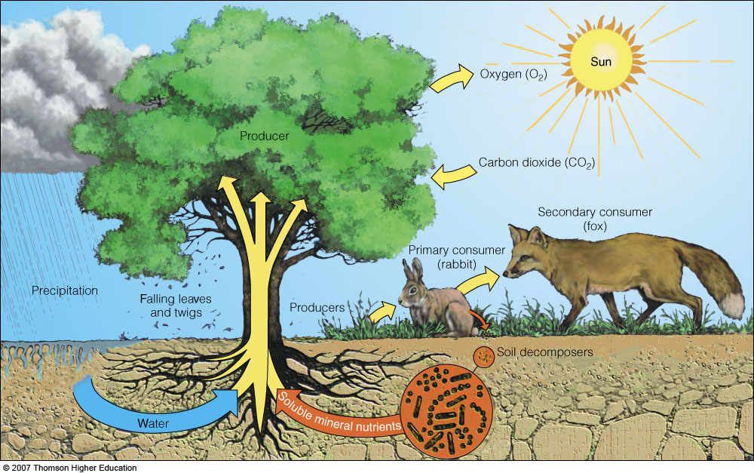
Nonliving and Living Components of Ecosystems
Ecosystems consist of nonliving (abiotic) and living (biotic) components.
Figure 3-10

Slide 17
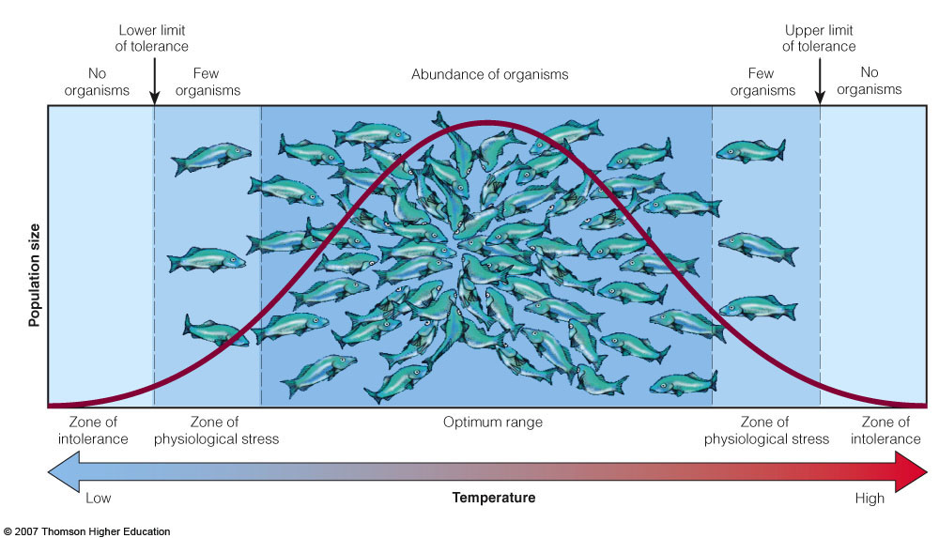
Factors That Limit Population Growth
Availability of matter and energy resources can limit the number of organisms in a population.
Figure 3-11

Slide 18
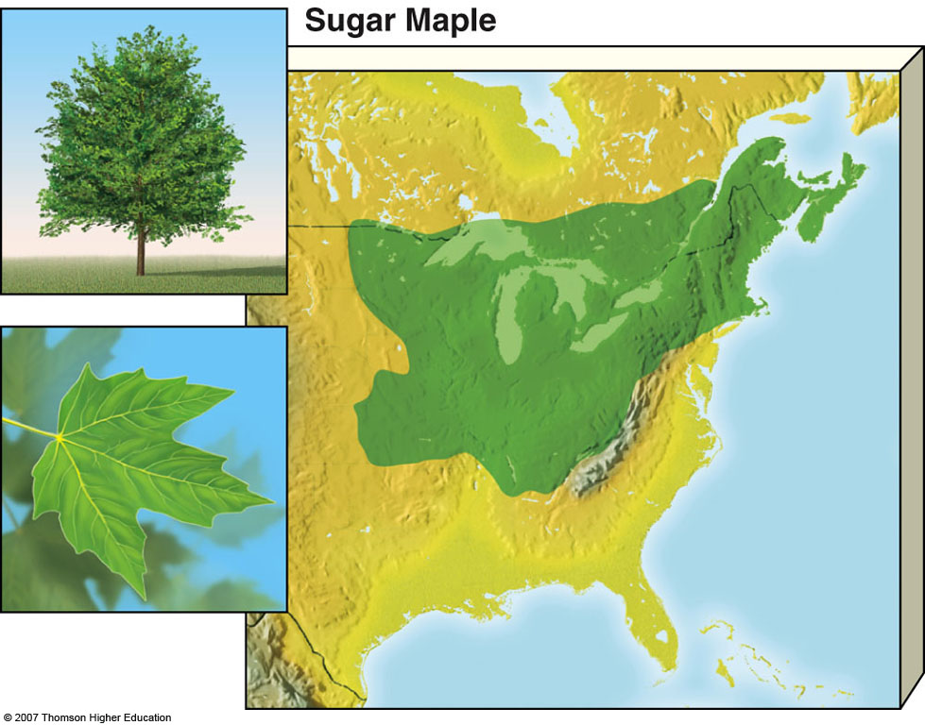
Factors That Limit Population Growth
The physical conditions of the environment can limit the distribution of a species.
Figure 3-12

Slide 19
Producers: Basic Source of All Food
Most producers capture sunlight to produce carbohydrates by photosynthesis:

Slide 20
Producers: Basic Source of All Food
Chemosynthesis:
Some organisms such as deep ocean bacteria draw energy from hydrothermal vents and produce carbohydrates from hydrogen sulfide (H₂S) gas .

Slide 21
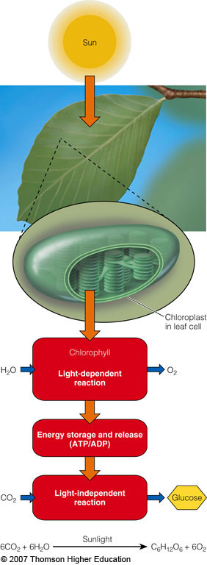
Photosynthesis: A Closer Look
Chlorophyll molecules in the chloroplasts of plant cells absorb solar energy.
This initiates a complex series of chemical reactions in which carbon dioxide and water are converted to sugars and oxygen.
Figure 3-A

Slide 22
Consumers: Eating and Recycling to Survive
Consumers (heterotrophs) get their food by eating or breaking down all or parts of other organisms or their remains.
Herbivores
Primary consumers that eat producers
Carnivores
Primary consumers eat primary consumers
Third and higher level consumers: carnivores that eat carnivores.
Omnivores
Feed on both plant and animals.

