Slide 1
Chapter 12 pgs. 275-293
Food, Soil Conservation, and Pest Management

Slide 2
Chapter Overview Questions
What is food security?
How serious are malnutrition and overnutrition?
How is the world’s food produced?
How are soils being degraded and eroded, and what can be done to reduce these losses?
What are the advantages and disadvantages of using the green revolution to produce food?

Slide 3
Chapter Overview Questions (cont’d)
What are the environmental effects of producing food?
What are the advantages and disadvantages of using genetic engineering to produce food?
How can we produce more meat, fish, and shellfish?
How can we protect food resources from pests?

Slide 4
Chapter Overview Questions (cont’d)
How do government policies affect food production and food security?
How can we produce food more sustainably?

Slide 5
Updates Online
The latest references for topics covered in this section can be found at the book companion website. Log in to the book’s e-resources page at www.thomsonedu.com to access InfoTrac articles.
InfoTrac: A renewable economy as a global ethic. Michael Lerner. The American Prospect, April 2006 v17 i4 pA30(2).
InfoTrac: Appetite for destruction. Kathleen McGowam. Audubon, July-August 2006 v108 i4 p70(2).
InfoTrac: Boom times for protein. Lester R. Brown. USA Today (Magazine) July 2006 v135 i2734 p59(1).
Union of Concerned Scientists: Genetic Engineering
USDA: Fueling the Green Revolution

Slide 6
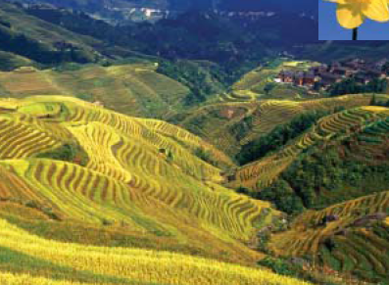
Core Case Study: Golden Rice -Grains of Hope or an Illusion?
Golden rice is a new genetically engineered strain of rice containing beta-carotene.
Can inexpensively supply vitamin A to malnourished.
Figure 13-1

Slide 7
Core Case Study: Golden Rice -Grains of Hope or an Illusion?
Critics contend that there are quicker and cheaper ways to supply vitamin A.
Scientist call for more evidence that the beta-carotene will be converted to vitamin A by the body.
Figure 13-1

Slide 8
FOOD SECURITY AND NUTRITION
Global food production has stayed ahead of population growth. However:
One of six people in developing countries cannot grow or buy the food they need.
Others cannot meet their basic energy needs (undernutrition / hunger) or protein and key nutrients (malnutrition).

Slide 9
FOOD SECURITY AND NUTRITION
The root cause of hunger and malnutrition is poverty.
Food security means that every person in a given area has daily access to enough nutritious food to have an active and healthy life.
Need large amounts of macronutrients (protein, carbohydrates, and fats).
Need smaller amounts of micronutrients (vitamins such as A,C, and E).

Slide 10
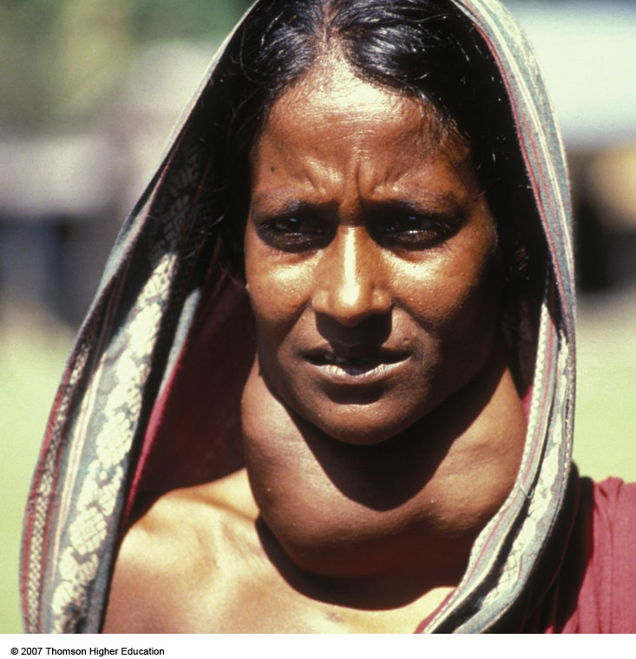
FOOD SECURITY AND NUTRITION
One in three people has a deficiency of one or more vitamins and minerals, especially vitamin A, iodine (causes goiter - enlargement of thyroid gland), and iron.
Figure 13-2

Slide 11
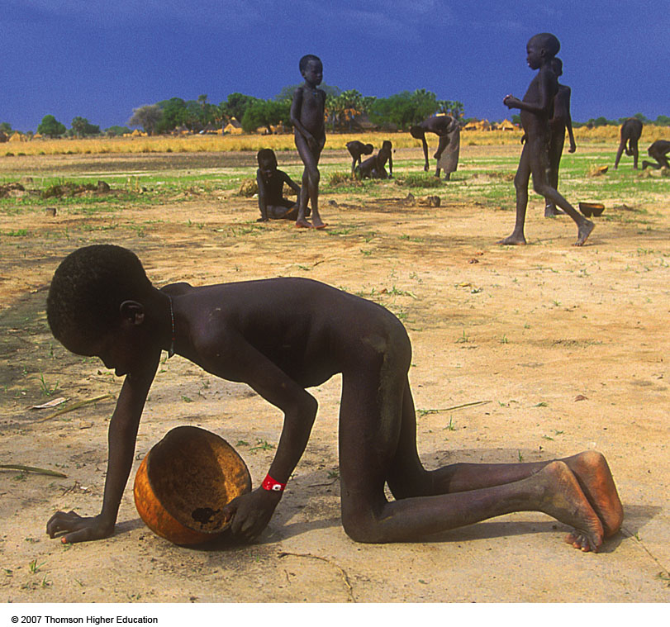
War and the Environment
Starving children collecting ants to eat in famine-stricken Sudan, Africa which has been involved in civil war since 1983.
Figure 13-3

Slide 12
Solutions: Reducing Childhood Deaths from Hunger and Malnutrition
There are several ways to reduce childhood deaths from nutrition-related causes:
Immunize children.
Encourage breast-feeding.
Prevent dehydration from diarrhea.
Prevent blindness from vitamin A deficiency.
Provide family planning.
Increase education for women.

Slide 14
Overnutrition: Eating Too Much
Overnutrition and lack of exercise can lead to reduced life quality, poor health, and premature death.
A 2005 Boston University study found that about 60% of American adults are overweight and 33% are obese (totaling 93%).
Americans spend $42 billion per year trying to lose weight.
$24 billion per year is needed to eliminate world hunger.

Slide 15
FOOD PRODUCTION
Food production from croplands, rangelands, ocean fisheries, and aquaculture has increased dramatically.
Wheat, rice, and corn provide more than half of the world’s consumed calories.
Fish and shellfish are an important source of food for about 1 billion people mostly in Asia and in coastal areas of developing countries.

Slide 16
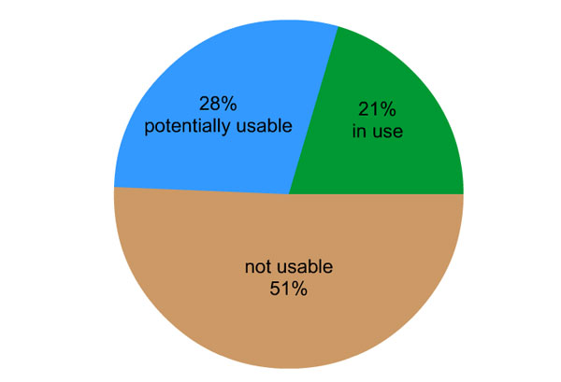
Animation: Land Use
PLAY
ANIMATION

Slide 17
Industrial Food Production: High Input Monocultures
About 80% of the world’s food supply is produced by industrialized agriculture.
Uses large amounts of fossil fuel energy, water, commercial fertilizers, and pesticides to produce monocultures.
Greenhouses are increasingly being used.
Plantations are being used in tropics for cash crops such as coffee, sugarcane, bananas.

Slide 18
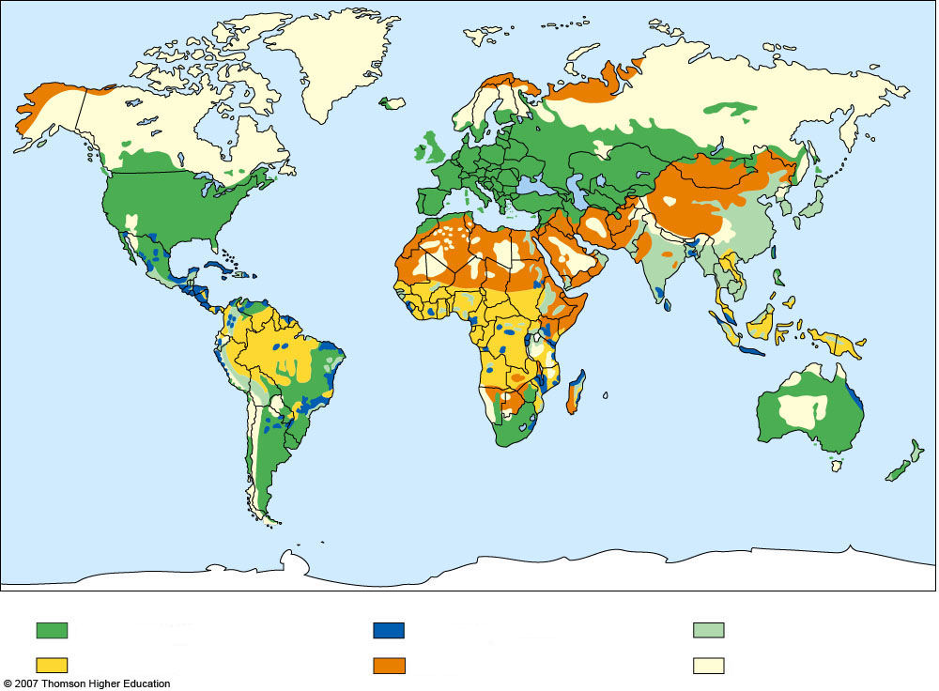
Industrialized agriculture
Plantation agriculture
Intensive traditional ag.
Shifting cultivation
Nomadic herding
No agriculture
Fig. 13-4, p. 275
Notes:
Figure 13.4
Natural capital: locations of the world’s principal types of food production.

Slide 19
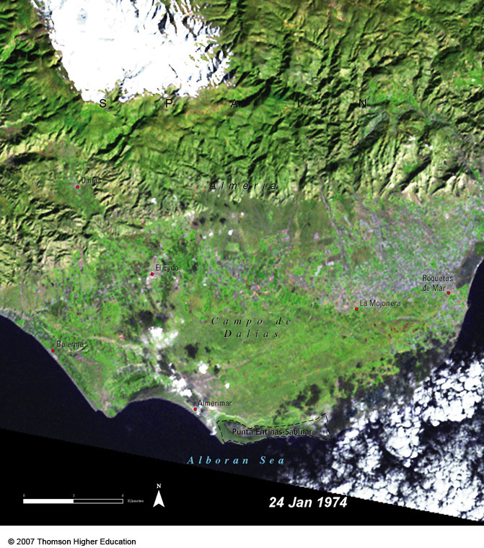
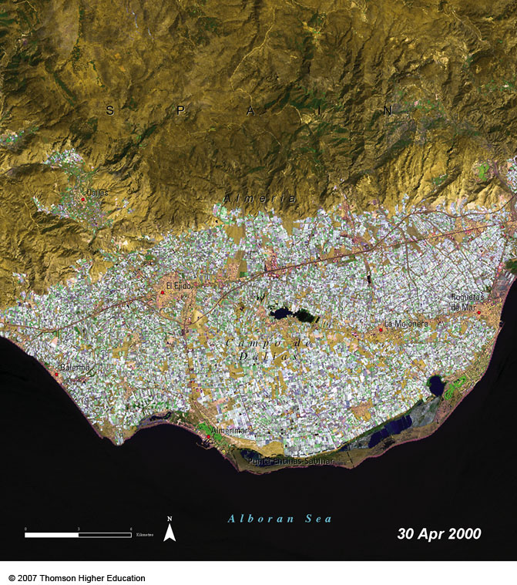
FOOD PRODUCTION
Satellite images of massive and rapid development of greenhouse food production in Spain from 1974 (left) to 2000 (right).
Figure 13-5

Slide 20
Industrial Food Production: High Input Monocultures
Livestock production in developed countries is industrialized:
Feedlots are used to fatten up cattle before slaughter.
Most pigs and chickens live in densely populated pens or cages.
Most livestock are fed grain grown on cropland.
Systems use a lot of energy and water and produce huge amounts of animal waste.

Slide 21
Natural Capital
Croplands
Ecological Services
Economic Services
• Help maintain water flow and soil infiltration
• Food crops
• Provide partial erosion protection
• Fiber crops
• Can build soil organic matter
• Crop genetic resources
• Store atmospheric carbon
• Provide wildlife habitat for some species
• Jobs
Fig. 13-6, p. 276
Notes:
Figure 13.6
Natural capital: ecological and economic services provided by croplands. QUESTION: Which two ecological and which two economic services do you think are the most important?

Slide 22
Case Study: Industrialized Food Production in the United States
The U.S. uses industrialized agriculture to produce about 17% of the world’s grain.
Relies on cheap energy to run machinery, process food, produce commercial fertilizer and pesticides.
About 10 units of nonrenewable fossil fuel energy are needed to put 1 unit of food energy on the table.

Slide 23
Case Study: Industrialized Food Production in the United States
Industrialized agriculture uses about 17% of all commercial energy in the U.S. and food travels an average 2,400 kilometers from farm to plate.
Figure 13-7

Slide 24
Food production
4%
2%
6%
5%
17% of total U.S. commercial energy use
Crops
Livestock
Food processing
Food distribution and preparation
Fig. 13-7, p. 277
Notes:
Figure 13.7
Natural capital degradation: Industrialized agriculture uses about 17% of all commercial energy in the United States and food travels an average 2,400 kilometers (1,300 miles) from farm to plate. The resulting pollution degrades the air and water and contributes to global warming. QUESTION: What might happen to your lifestyle if the price of oil rises sharply? (Data from David Pimentel and Worldwatch Institute)

Slide 25
Traditional Agriculture: Low Input Polyculture
Many farmers in developing countries use low-input agriculture to grow a variety of crops on each plot of land (interplanting) through:
Polyvarietal cultivation: planting several genetic varieties.
Intercropping: two or more different crops grown at the same time in a plot.
Agroforestry: crops and trees are grown together.
Polyculture: different plants are planted together.

Slide 26
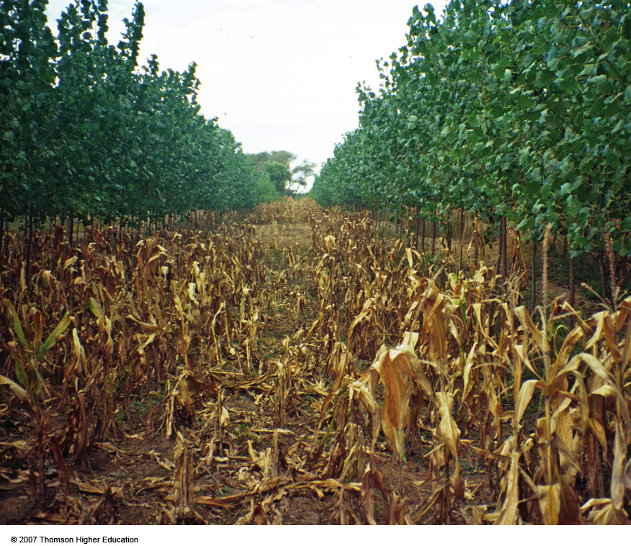
Traditional Agriculture: Low Input Polyculture
Research has shown that, on average, low input polyculture produces higher yields than high-input monoculture.
Figure 13-8

Slide 27
SOIL EROSION AND DEGRADATION
Soil erosion lowers soil fertility and can overload nearby bodies of water with eroded sediment.
Sheet erosion: surface water or wind peel off thin layers of soil.
Rill erosion: fast-flowing little rivulets of surface water make small channels.
Gully erosion: fast-flowing water join together to cut wider and deeper ditches or gullies.

Slide 28
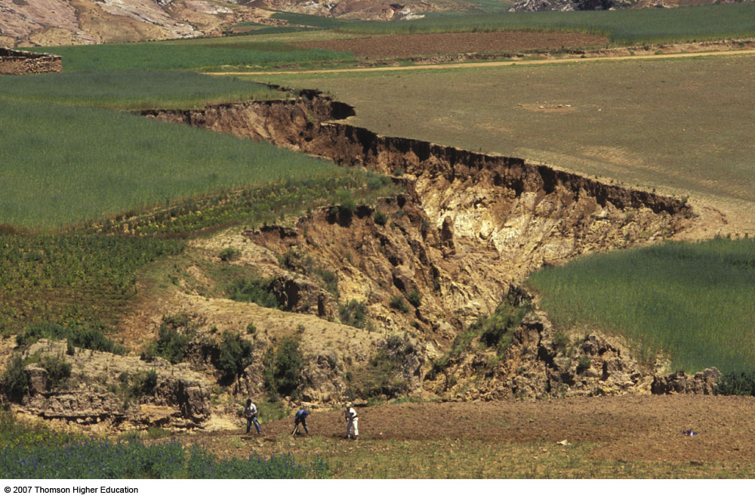
SOIL EROSION AND DEGRADATION
Soil erosion is the movement of soil components, especially surface litter and topsoil, by wind or water.
Soil erosion increases through activities such as farming, logging, construction, overgrazing, and off-road vehicles.
Figure 13-9

Slide 29
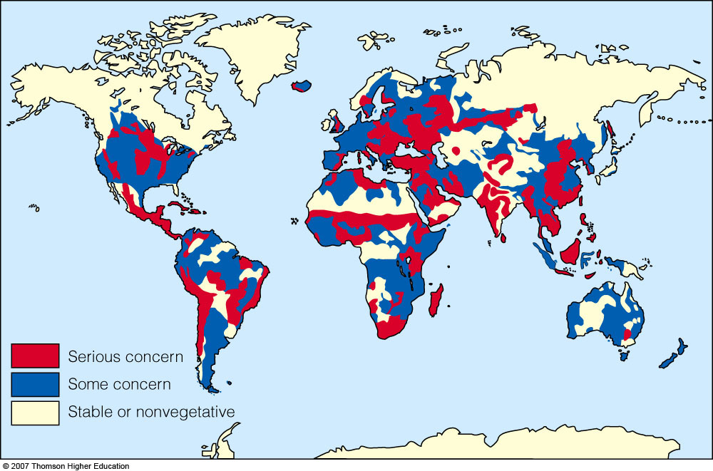
Global Outlook: Soil Erosion
Soil is eroding faster than it is forming on more than one-third of the world’s cropland.
Figure 13-10

Slide 30
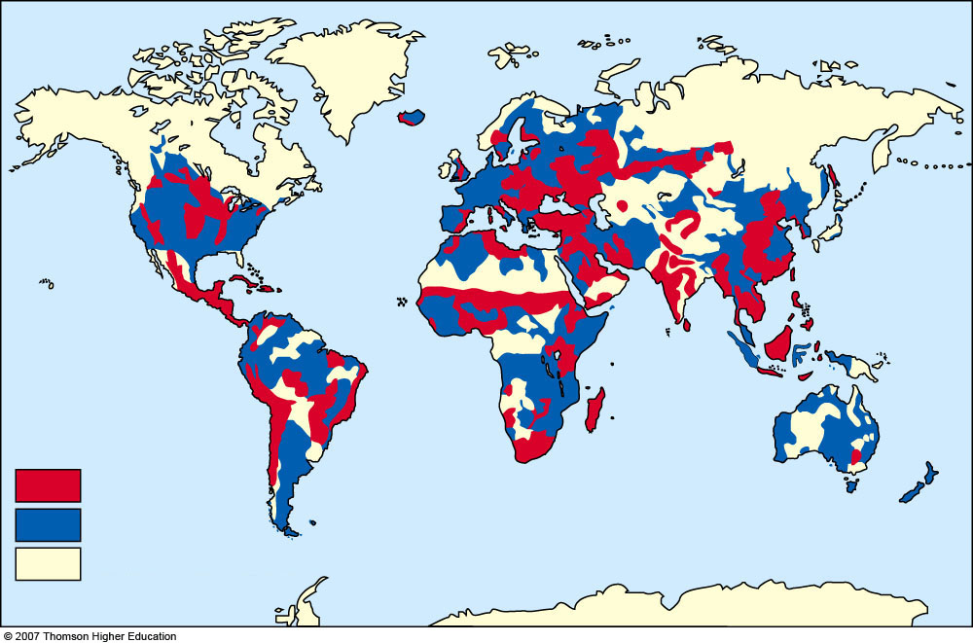
Serious concern
Some concern
Stable or nonvegetative
Fig. 13-10, p. 279
Notes:
Figure 13.10
Natural capital degradation: global soil erosion. Three-quarters of Africa’s farmland is severely depleted of soil nutrients, compared with 40% in 1995. The reason is that because of population growth and poverty, farmers grow crop after crop, depleting the soil’s fertility. If this continues, crop yield in Africa, already very low, could fall as much as 30% by 2020. The result is more frequent famines and increasing dependence on food aid and imports. QUESTION: How serious is soil erosion where you live? (Data from UN Environment Programme and the World Resources Institute)

Slide 31
Case Study: Soil Erosion in the U.S. – Some Hopeful Signs
Soil erodes faster than it forms on most U.S. cropland, but since 1985, has been cut by about 40%.
1985 Food Security Act (Farm Act): farmers receive a subsidy for taking highly erodible land out of production and replanting it with soil saving plants for 10-15 years.

Slide 32
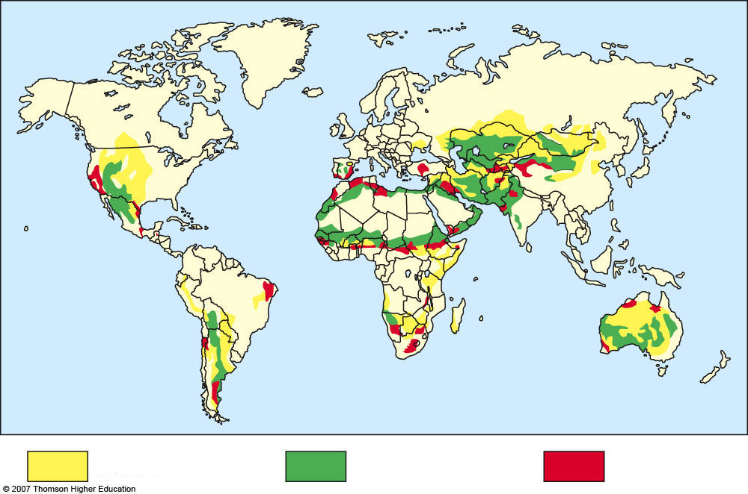
Moderate
Severe
Very severe
Fig. 13-11, p. 280
Notes:
Figure 13.11
Natural capital degradation: desertification of arid and semiarid lands is caused by a combination of prolonged drought and human activities that expose soil to erosion. QUESTION: What three things would you do to reduce desertification? (Data from UN Environment Programme and Harold E. Drengue)

Slide 33
Desertification: Degrading Drylands
About one-third of the world’s land has lost some of its productivity because of drought and human activities that reduce or degrade topsoil.
Figure 13-12

Slide 34
Causes
Consequences
Overgrazing
Worsening
drought
Deforestation
Erosion
Famine
Salinization
Economic losses
Soil compaction
Lower living standards
Natural climate change
Environmental refugees
Fig. 13-12, p. 280
Notes:
Figure 13.12
Natural capital degradation: causes and consequences of desertification. QUESTION: How serious is the threat of desertification where you live?

Slide 35
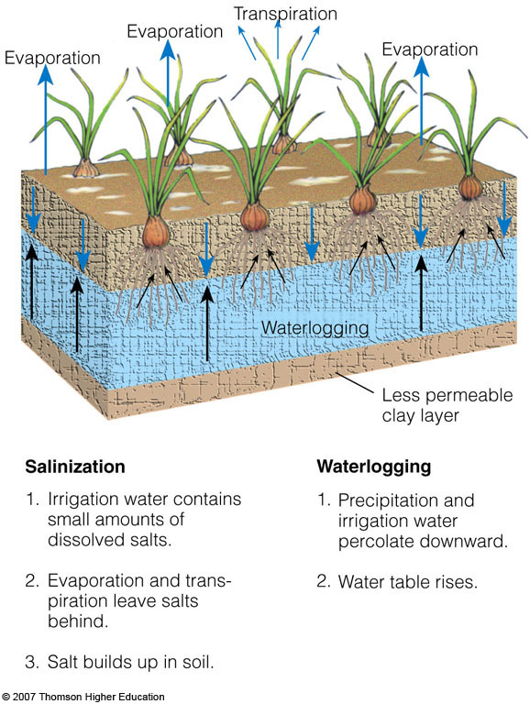
Salinization and Waterlogging
Repeated irrigation can reduce crop yields by causing salt buildup in the soil and waterlogging of crop plants.
Figure 13-13

Slide 36
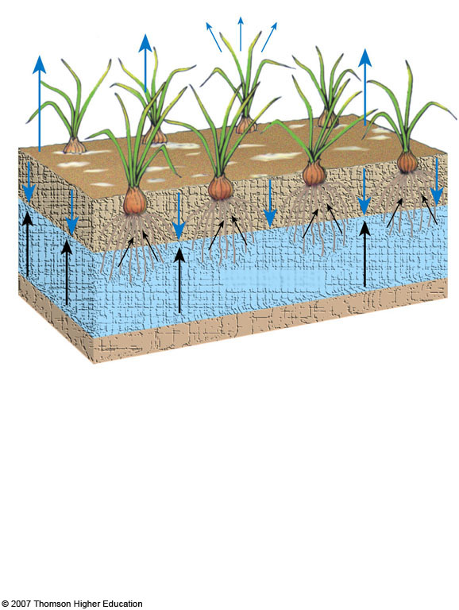
Transpiration
Evaporation
Evaporation
Evaporation
Waterlogging
Less permeable clay layer
Salinization
Waterlogging
1. Irrigation water contains small amounts of dissolved salts
1. Precipitation and irrigation water percolate downward.
2. Evaporation and transpiration leave salts behind.
2. Water table rises.
3. Salt builds up in soil.
Fig. 13-13, p. 281
Notes:
Figure 13.13
Natural capital degradation: salinization and waterlogging of soil on irrigated land without adequate drainage can decrease crop yields.

Slide 37
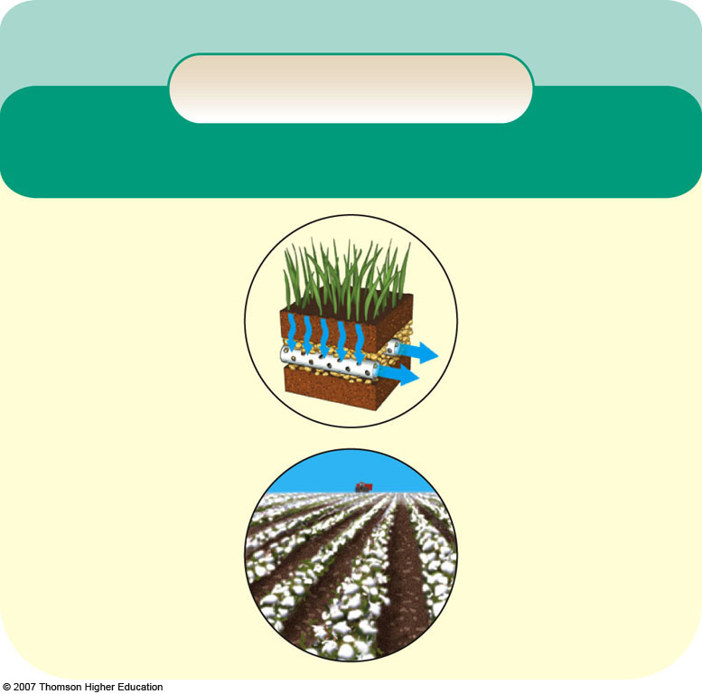
Solutions
Soil Salinization
Prevention
Cleanup
Reduce irrigation
Flush soil (expensive and wastes water)
Stop growing crops for 2–5 years
Switch to salt-tolerant crops (such as barley, cotton, sugarbeet)
Install underground drainage systems (expensive)
Fig. 13-15, p. 281
Notes:
Figure 13.15
Solutions: methods for preventing and cleaning up soil salinization. QUESTION: Which two of these solutions do you think are the most important?

Slide 38
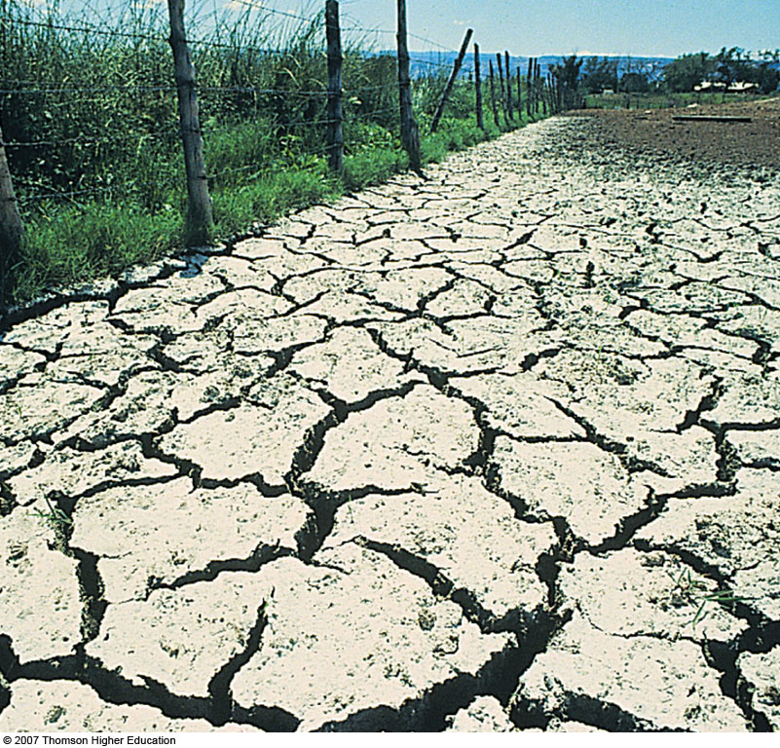
Salinization and Waterlogging of Soils: A Downside of Irrigation
Example of high evaporation, poor drainage, and severe salinization.
White alkaline salts have displaced cops.
Figure 13-14

Slide 39
SUSTAINABLE AGRICULTURE THROUGH SOIL CONSERVATION
Modern farm machinery can plant crops without disturbing soil (no-till and minimum tillage.
Conservation-tillage farming:
Increases crop yield.
Raises soil carbon content.
Lowers water use.
Lowers pesticides.
Uses less tractor fuel.

Slide 40
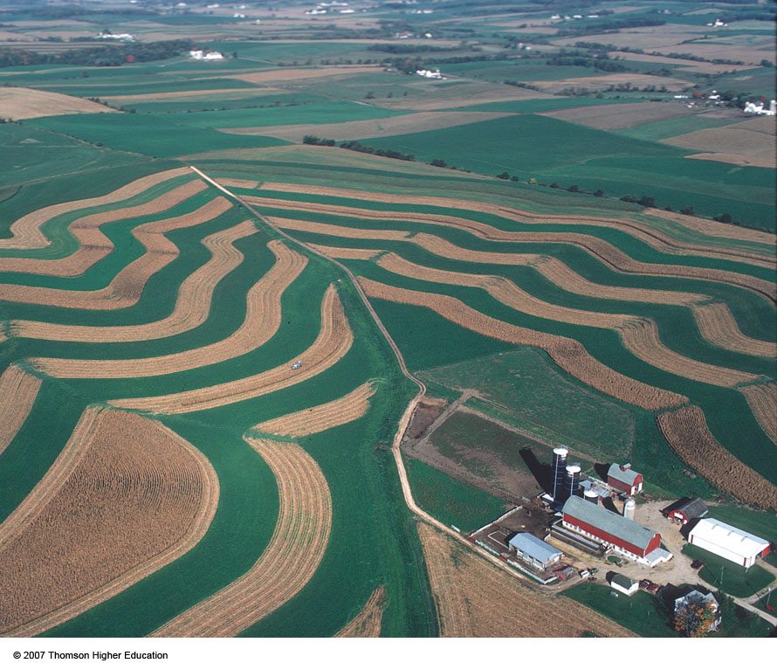
SUSTAINABLE AGRICULTURE THROUGH SOIL CONSERVATION
Terracing, contour planting, strip cropping, alley cropping, and windbreaks can reduce soil erosion.
Figure 13-16

Slide 41
SUSTAINABLE AGRICULTURE THROUGH SOIL CONSERVATION
Fertilizers can help restore soil nutrients, but runoff of inorganic fertilizers can cause water pollution.
Organic fertilizers: from plant and animal (fresh, manure, or compost) materials.
Commercial inorganic fertilizers: Active ingredients contain nitrogen, phosphorous, and potassium and other trace nutrients.

Slide 42
THE GREEN REVOLUTION AND ITS ENVIRONMENTAL IMPACT
Since 1950, high-input agriculture has produced more crops per unit of land.
In 1967, fast growing dwarf varieties of rice and wheat were developed for tropics and subtropics.
Figure 13-17

Slide 43
THE GREEN REVOLUTION AND ITS ENVIRONMENTAL IMPACT
Lack of water, high costs for small farmers, and physical limits to increasing crop yields hinder expansion of the green revolution.
Since 1978 the amount of irrigated land per person has declined due to:
Depletion of underground water supplies.
Inefficient irrigation methods.
Salt build-up.
Cost of irrigating crops.

Slide 44
THE GREEN REVOLUTION AND ITS ENVIRONMENTAL IMPACT
Modern agriculture has a greater harmful environmental impact than any human activity.
Loss of a variety of genetically different crop and livestock strains might limit raw material needed for future green and gene revolutions.
In the U.S., 97% of the food plant varieties available in the 1940 no longer exist in large quantities.

Slide 45
Biodiversity Loss
Soil
Water
Air Pollution
Human Health
Loss and degradation of grasslands, forests, and wetlands
Erosion
Water waste
Greenhouse gas emissions from fossil fuel use
Nitrates in drinking water
Loss of fertility
Aquifer depletion
Salinization
Increased runoff and flooding from cleared land
Pesticide residues in drinking water, food, and air
Other air pollutants from fossil fuel use
Waterlogging
Fish kills from pesticide runoff
Desertification
Sediment pollution from erosion
Contamination of drinking and swimming water with disease organisms from livestock wastes
Greenhouse gas emissions of nitrous oxide from use of inorganic fertilizers
Fish kills from pesticide runoff
Killing wild predators to protect livestock
Surface and groundwater pollution from pesticides and fertilizers
Loss of genetic diversity of wild crop strains replaced by monoculture strains
Belching of the greenhouse gas methane by cattle
Overfertilization of lakes and rivers from runoff of fertilizers, livestock wastes, and food processing wastes
Bacterial contamination of meat
Pollution from pesticide sprays
Fig. 13-18, p. 285
Notes:
Figure 13.18
Natural capital degradation: major harmful environmental effects of food production. According to a 2002 study by the United Nations, nearly 30% of the world’s cropland has been degraded to some degree by soil erosion, salt buildup, and chemical pollution, and 17% has been seriously degraded. QUESTION: Which item in each of these categories do you think is the most harmful?

Slide 46
THE GENE REVOLUTION
To increase crop yields, we can mix the genes of similar types of organisms and mix the genes of different organisms.
Artificial selection has been used for centuries to develop genetically improved varieties of crops.
Genetic engineering develops improved strains at an exponential pace compared to artificial selection.
Controversy has arisen over the use of genetically modified food (GMF).

Slide 47
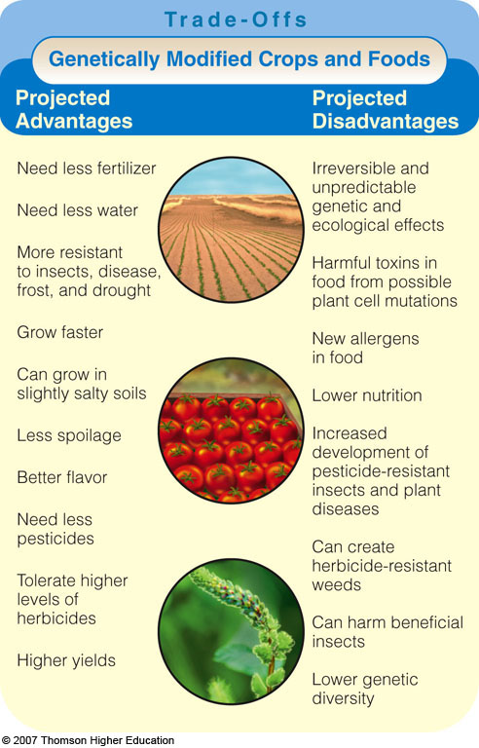
Mixing Genes
Genetic engineering involves splicing a gene from one species and transplanting the DNA into another species.
Figure 13-19

Slide 48
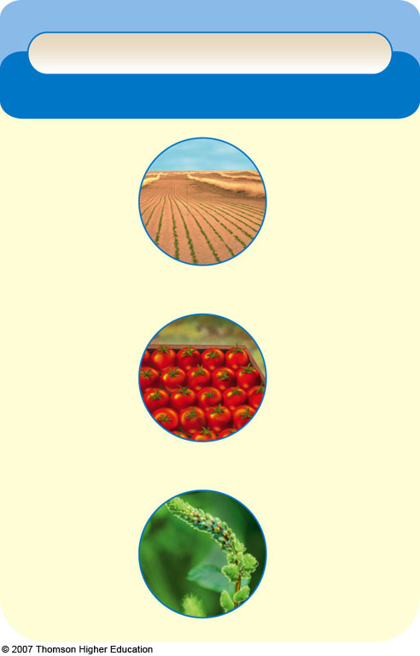
Trade-Offs
Genetically Modified Crops and Foods
Projected Advantages
Projected Disadvantages
Need less fertilizer
Irreversible and unpredictable genetic and ecological effects
Need less water
More resistant to insects, disease, frost, and drought
Harmful toxins in food from possible plant cell mutations
Grow faster
New allergens in food
Can grow in slightly salty soils
Lower nutrition
Increased development of pesticide-resistant insects and plant diseases
Less spoilage
Better flavor
Need less pesticides
Can create herbicide-resistant weeds
Tolerate higher levels of herbicides
Can harm beneficial insects
Higher yields
Lower genetic diversity
Fig. 13-19, p. 287
Notes:
Figure 13.19
Trade-offs: projected advantages and disadvantages of genetically modified crops and foods. QUESTION: Which two advantages and and which two disadvantages do you think are the most important?

Slide 49
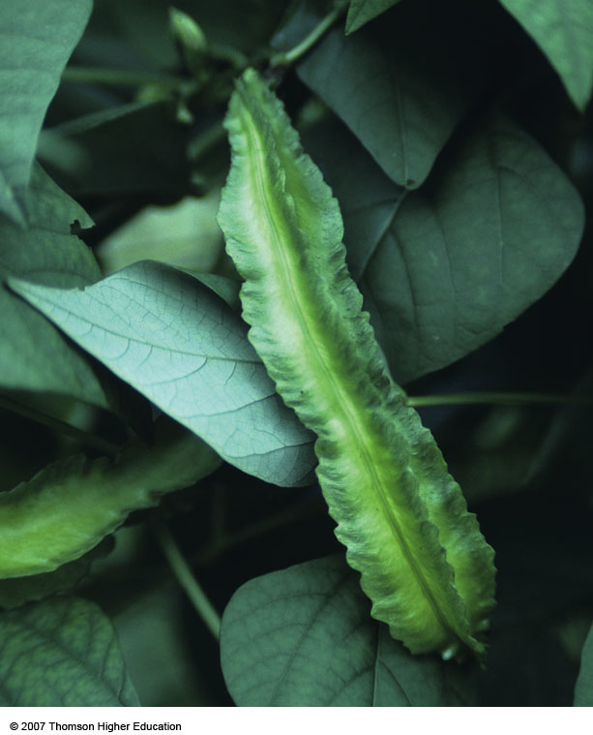
THE GENE REVOLUTION
The winged bean, a GMF, could be grown to help reduce malnutrition and the use of large amounts of inorganic fertilizers.
Figure 13-20

Slide 50
How Would You Vote?
To conduct an instant in-class survey using a classroom response system, access “JoinIn Clicker Content” from the PowerLecture main menu for Living in the Environment.
Do the advantages of genetically engineered foods outweigh their disadvantages?
a. No. The impact of these foods could cause serious harm to the environment or human health.
b. Yes. These foods are needed to combat world hunger.

Slide 51
THE GENE REVOLUTION
Controversy has arisen over the use of genetically modified food (GMF).
Critics fear that we know too little about the long-term potential harm to human and ecosystem health.
There is controversy over legal ownership of genetically modified crop varieties and whether GMFs should be labeled.

Slide 52
PRODUCING MORE MEAT
About half of the world’s meat is produced by livestock grazing on grass.
The other half is produced under factory-like conditions (feedlots).
Densely packed livestock are fed grain or fish meal.
Eating more chicken and farm-raised fish and less beef and pork reduces harmful environmental impacts of meat production.

Slide 53
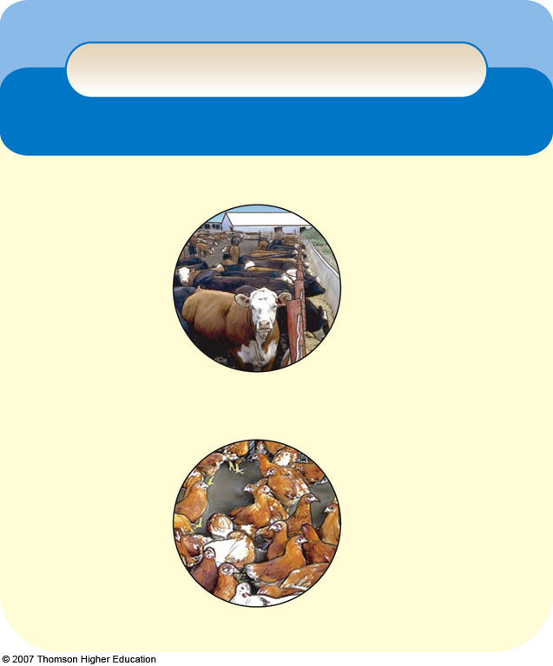
Trade-Offs
Animal Feedlots
Advantages
Disadvantages
Increased meat production
Need large inputs of grain, fish meal, water, and fossil fuels
Higher profits
Less land use
Concentrate animal wastes that can pollute water
Reduced overgrazing
Reduced soil erosion
Antibiotics can increase genetic resistance to microbes in humans
Help protect biodiversity
Fig. 13-21, p. 289
Notes:
Figure 13.21
Trade-offs: advantages and disadvantages of animal feedlots. QUESTION: Which single advantage and which single disadvantage do you think are the most important?

Slide 54
How Many People can the World Support? Food Production and Population
The number of people the world can support depends mostly on their per capita consumption of grain and meat and how many children couples have.
Research has shown that those living very low on the food chain or very high on the food chain do not live as long as those that live somewhere in between.

Slide 55
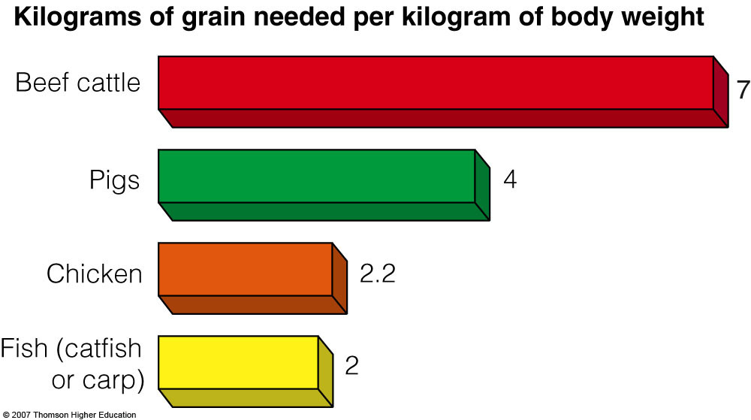
PRODUCING MORE MEAT
Efficiency of converting grain into animal protein.
Figure 13-22

Slide 56
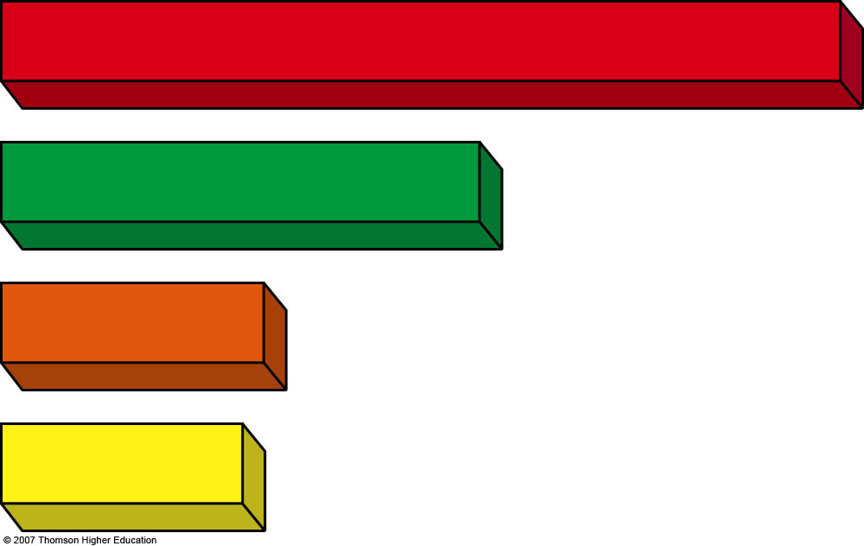
Kilograms of grain needed per kilogram of body weight
Beef cattle
7
Pigs
4
Chicken
2.2
Fish (catfish or carp)
2
Fig. 13-22, p. 290
Notes:
Figure 13.22
Efficiency of converting grain into animal protein. Data in kilograms of grain per kilogram of body weight added. QUESTION: If you eat meat, what two shifts in meat consumption would reduce your environmental impact? (Data from U.S. Department of Agriculture)

Slide 57
CATCHING AND RAISING MORE FISH AND SHELLFISH
After spectacular increases, the world’s total and per capita marine and freshwater fish and shellfish catches have leveled off.
Figure 13-23

Slide 58
Catch (millions of metric tons)
Per capita catch (kilograms per person)
Wild catch
Aquaculture
Year
Year
Total World Fish Catch
World Fish Catch per Person
Fig. 13-23, p. 291
Notes:
Figure 13.23
Natural capital degradation: world fish catch (left) and world fish catch per person (right), 1950–2003. Estimates for both since 1990 may be about 10% lower than shown here, because it was discovered that China had been inflating its fish catches since 1990. QUESTION: Why do you think the per capita fish catch has leveled off? (Data from UN Food and Agriculture Organization, U.S. Census Bureau, and Worldwatch Institute)

Slide 59
CATCHING AND RAISING MORE FISH AND SHELLFISH
Government subsidies given to the fishing industry are a major cause of overfishing.
Global fishing industry spends about $25 billion per year more than its catch is worth.
Without subsidies many fishing fleets would have to go out of business.
Subsidies allow excess fishing with some keeping their jobs longer with making less money.

Slide 60
Aquaculture: Aquatic Feedlots
Raising large numbers of fish and shellfish in ponds and cages is world’s fastest growing type of food production.
Fish farming involves cultivating fish in a controlled environment and harvesting them in captivity.
Fish ranching involves holding anadromous species that live part of their lives in freshwater and part in saltwater.
Fish are held for the first few years, released, and then harvested when they return to spawn.

Slide 61
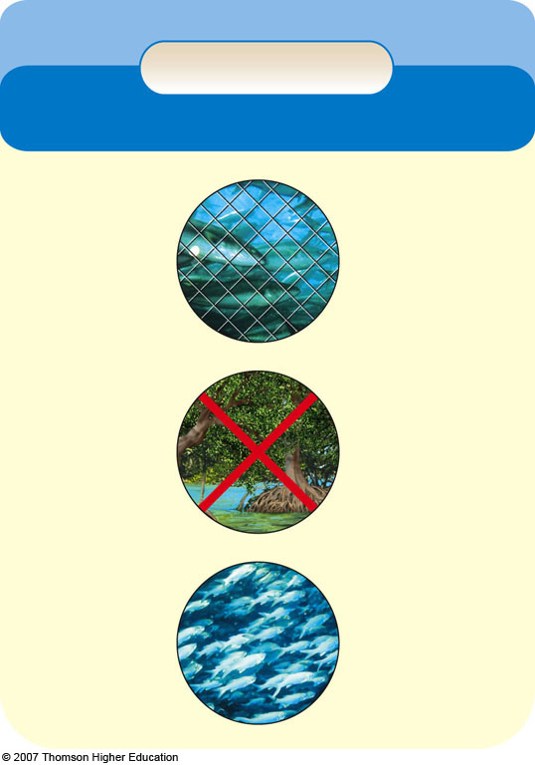
Trade-Offs
Aquaculture
Advantages
Disadvantages
High efficiency
Needs large inputs of land, feed, and water
High yield in small volume of water
Large waste output
Destroys mangrove forests and estuaries
Can reduce overharvesting of conventional fisheries
Uses grain to feed some species
Low fuel use
Dense populations vulnerable to disease
High profits
Tanks too contaminated to use after about 5 years
Profits not tied to price of oil
Fig. 13-24, p. 292
Notes:
Figure 13.24
Trade-offs: advantages and disadvantages of aquaculture. QUESTION: Which two advantages and which two disadvantages do you think are the most important?

Slide 62
Solutions
More Sustainable Aquaculture
• Use less fishmeal feed to reduce depletion of other fish
• Improve management of aquaculture wastes
• Reduce escape of aquaculture species into the wild
• Restrict location of fish farms to reduce loss of mangrove forests and estuaries
• Farm some aquaculture species in deeply submerged cages to protect them from wave action and predators and allow dilution of wastes into the ocean
• Certify sustainable forms of aquaculture
Fig. 13-25, p. 293
Notes:
Figure 13.25
Solutions: ways to make aquaculture more sustainable and reduce its harmful environmental effects. QUESTION: Which two of these solutions do you think are the most important?

