Slide 1
Chapter 10 229-245
Sustaining Terrestrial Biodiversity: The Ecosystem Approach

Slide 2
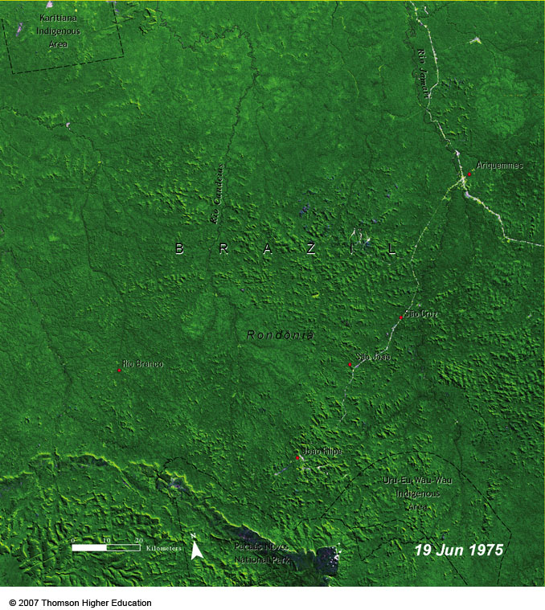
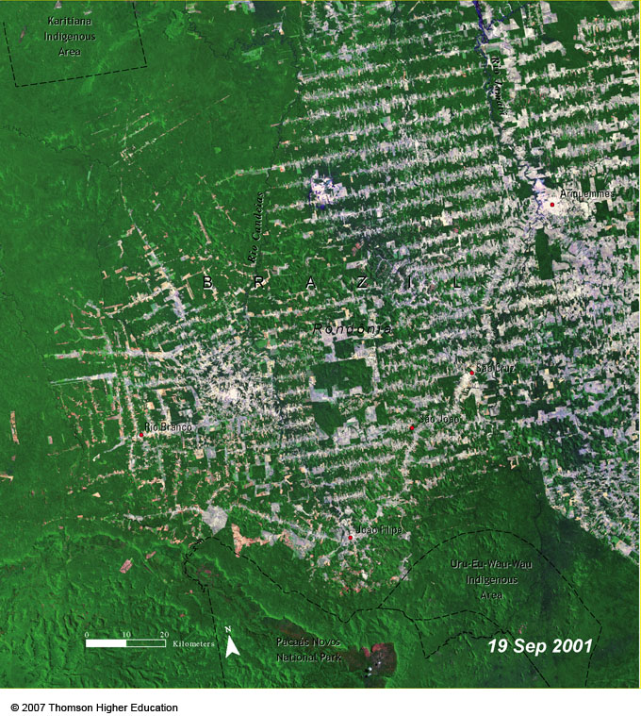
CASE STUDY: TROPICAL DEFORESTATION
Large areas of ecologically and economically important tropical forests are being cleared and degraded at a fast rate.
Figure 10-16

Slide 3
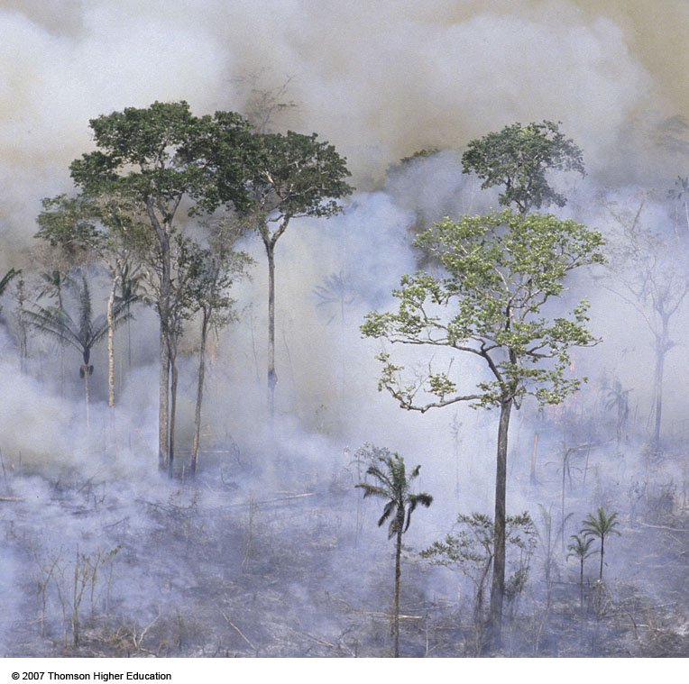
CASE STUDY: TROPICAL DEFORESTATION
At least half of the world’s terrestrial plant and animal species live in tropical rain forests.
Large areas of tropical forest are burned to make way for cattle ranches and crops.
Figure 10-17

Slide 4
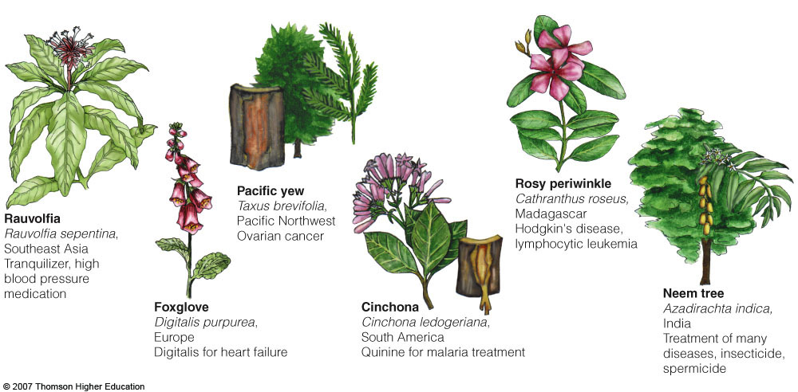
Why Should We Care about the Loss of Tropical Forests?
About 2,100 of the 3,000 plants identified by the National Cancer Institute as sources of cancer-fighting chemicals come from tropical forests.
Figure 10-18

Slide 5
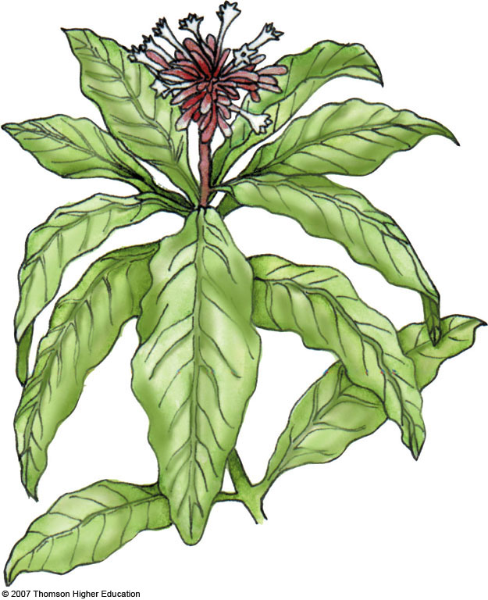
Rauvolfia
Rauvolfia sepentina,
Southeast Asia
Tranquilizer, high
blood pressure
medication
Fig. 10-18a, p. 205
Notes:
Figure 10.18
Natural capital: nature’s pharmacy. Parts of these and a number of other plants and animals (many of them found in tropical forests) are used to treat a variety of human ailments and diseases. Nine of the ten leading prescription drugs originally came from wild organisms. About 2,100 of the 3,000 plants identified by the National Cancer Institute as sources of cancer-fighting chemicals come from tropical forests. Despite their economic and health potential, fewer than 1% of the estimated 125,000 flowering plant species in tropical forests (and a mere 1,100 of the world’s 260,000 known plant species) have been examined for their medicinal properties. Once the active ingredients in the plants have been identified, they can usually be produced synthetically. Many of these tropical plant species are likely to become extinct before we can study them.

Slide 6
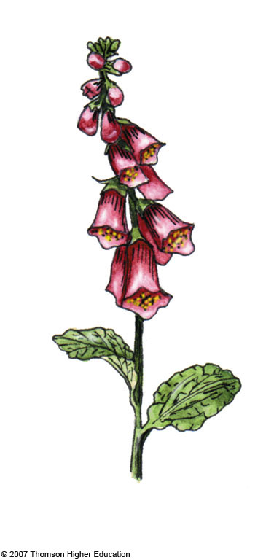
Foxglove
Digitalis purpurea,
Europe
Digitalis for heart failure
Fig. 10-18b, p. 205
Notes:
Figure 10.18
Natural capital: nature’s pharmacy. Parts of these and a number of other plants and animals (many of them found in tropical forests) are used to treat a variety of human ailments and diseases. Nine of the ten leading prescription drugs originally came from wild organisms. About 2,100 of the 3,000 plants identified by the National Cancer Institute as sources of cancer-fighting chemicals come from tropical forests. Despite their economic and health potential, fewer than 1% of the estimated 125,000 flowering plant species in tropical forests (and a mere 1,100 of the world’s 260,000 known plant species) have been examined for their medicinal properties. Once the active ingredients in the plants have been identified, they can usually be produced synthetically. Many of these tropical plant species are likely to become extinct before we can study them.

Slide 7
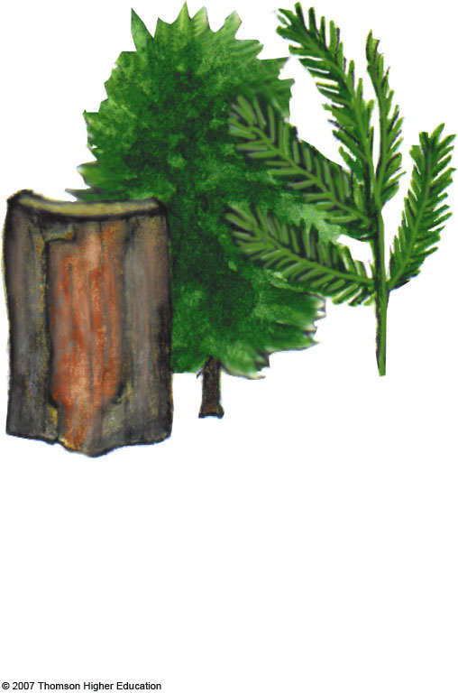
Pacific yew
Taxus brevifolia,
Pacific Northwest
Ovarian cancer
Fig. 10-18c, p. 205
Notes:
Figure 10.18
Natural capital: nature’s pharmacy. Parts of these and a number of other plants and animals (many of them found in tropical forests) are used to treat a variety of human ailments and diseases. Nine of the ten leading prescription drugs originally came from wild organisms. About 2,100 of the 3,000 plants identified by the National Cancer Institute as sources of cancer-fighting chemicals come from tropical forests. Despite their economic and health potential, fewer than 1% of the estimated 125,000 flowering plant species in tropical forests (and a mere 1,100 of the world’s 260,000 known plant species) have been examined for their medicinal properties. Once the active ingredients in the plants have been identified, they can usually be produced synthetically. Many of these tropical plant species are likely to become extinct before we can study them.

Slide 8
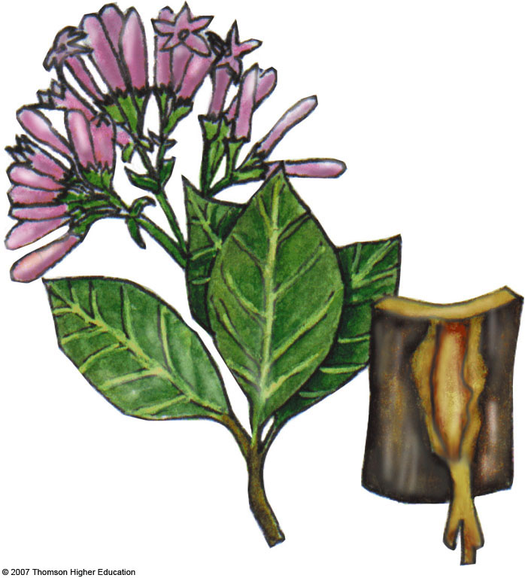
Cinchona
Cinchona ledogeriana,
South America
Quinine for malaria treatment
Fig. 10-18d, p. 205
Notes:
Figure 10.18
Natural capital: nature’s pharmacy. Parts of these and a number of other plants and animals (many of them found in tropical forests) are used to treat a variety of human ailments and diseases. Nine of the ten leading prescription drugs originally came from wild organisms. About 2,100 of the 3,000 plants identified by the National Cancer Institute as sources of cancer-fighting chemicals come from tropical forests. Despite their economic and health potential, fewer than 1% of the estimated 125,000 flowering plant species in tropical forests (and a mere 1,100 of the world’s 260,000 known plant species) have been examined for their medicinal properties. Once the active ingredients in the plants have been identified, they can usually be produced synthetically. Many of these tropical plant species are likely to become extinct before we can study them.

Slide 9
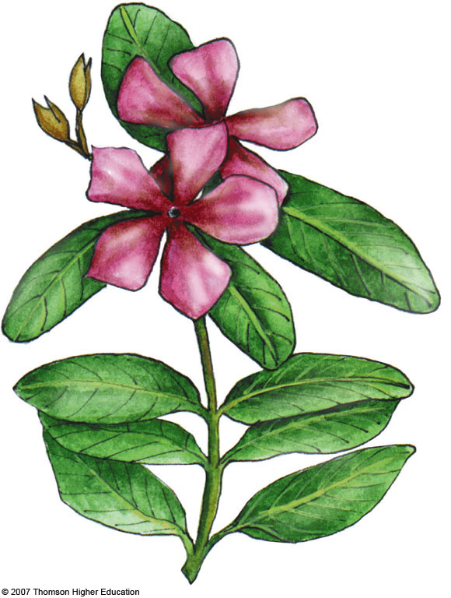
Rosy periwinkle
Cathranthus roseus,
Madagascar
Hodgkin's disease,
lymphocytic leukemia
Fig. 10-18e, p. 205
Notes:
Figure 10.18
Natural capital: nature’s pharmacy. Parts of these and a number of other plants and animals (many of them found in tropical forests) are used to treat a variety of human ailments and diseases. Nine of the ten leading prescription drugs originally came from wild organisms. About 2,100 of the 3,000 plants identified by the National Cancer Institute as sources of cancer-fighting chemicals come from tropical forests. Despite their economic and health potential, fewer than 1% of the estimated 125,000 flowering plant species in tropical forests (and a mere 1,100 of the world’s 260,000 known plant species) have been examined for their medicinal properties. Once the active ingredients in the plants have been identified, they can usually be produced synthetically. Many of these tropical plant species are likely to become extinct before we can study them.

Slide 10
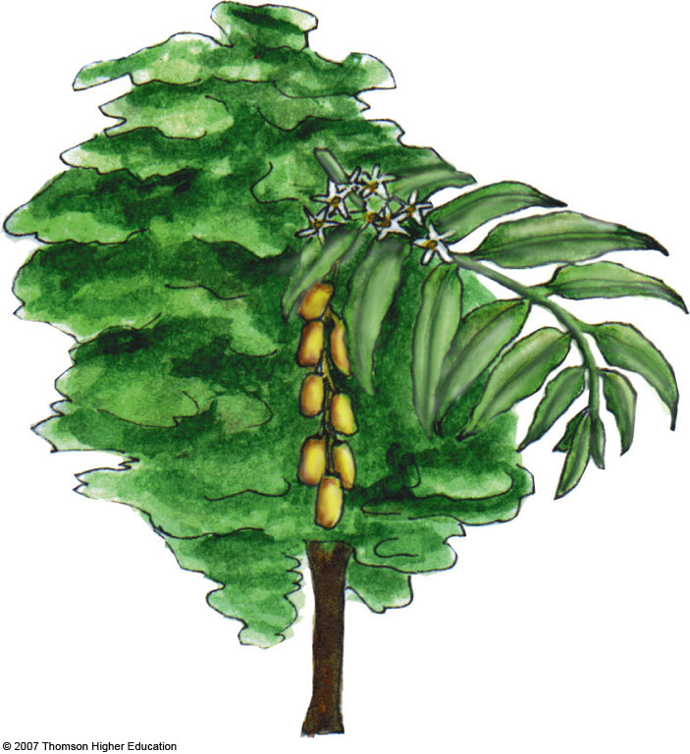
Neem tree
Azadirachta indica,
India
Treatment of many
diseases, insecticide,
spermicide
Fig. 10-18f, p. 205
Notes:
Figure 10.18
Natural capital: nature’s pharmacy. Parts of these and a number of other plants and animals (many of them found in tropical forests) are used to treat a variety of human ailments and diseases. Nine of the ten leading prescription drugs originally came from wild organisms. About 2,100 of the 3,000 plants identified by the National Cancer Institute as sources of cancer-fighting chemicals come from tropical forests. Despite their economic and health potential, fewer than 1% of the estimated 125,000 flowering plant species in tropical forests (and a mere 1,100 of the world’s 260,000 known plant species) have been examined for their medicinal properties. Once the active ingredients in the plants have been identified, they can usually be produced synthetically. Many of these tropical plant species are likely to become extinct before we can study them.

Slide 11
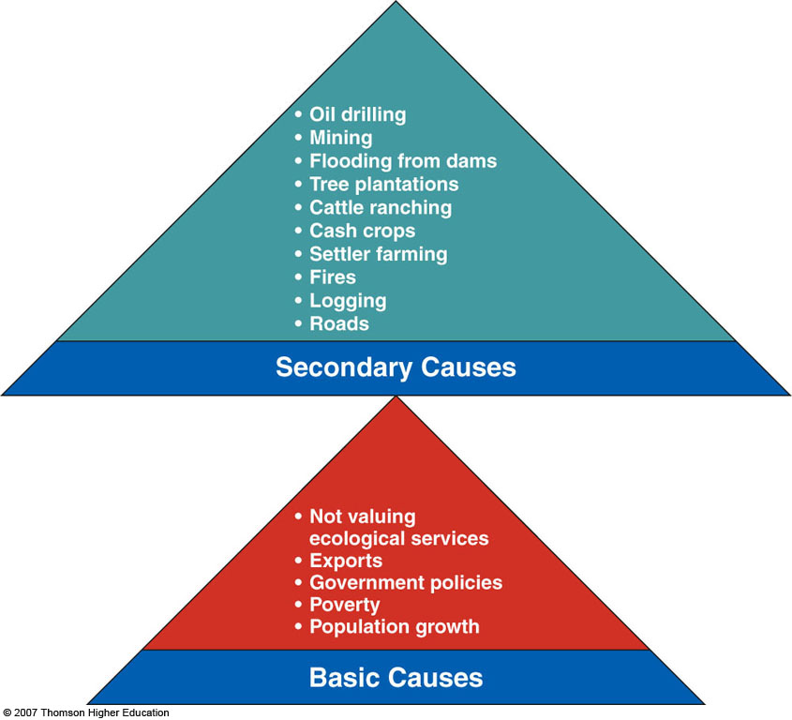
Causes of Tropical Deforestation and Degradation
Tropical deforestation results from a number of interconnected primary and secondary causes.
Figure 10-19

Slide 12
• Oil drilling
• Mining
• Flooding from dams
• Tree plantations
• Cattle ranching
• Cash crops
• Settler farming
• Fires
• Logging
• Roads
Secondary Causes
• Not valuing
ecological services
• Exports
• Government policies
• Poverty
• Population growth
Basic Causes
Fig. 10-19, p. 206
Notes:
Figure 10.19
Natural capital degradation: major interconnected causes of the destruction and degradation of tropical forests. The importance of specific secondary causes varies in different parts of the world.

Slide 13
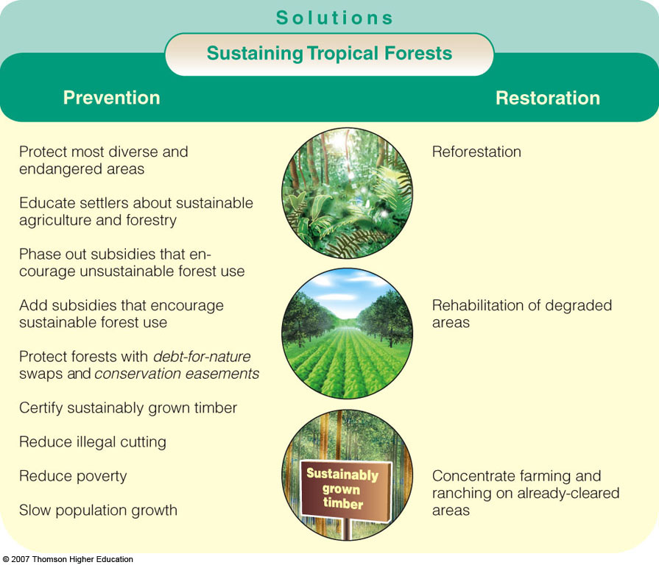
Solutions
Sustaining Tropical Forests
Prevention
Restoration
Protect most diverse and endangered areas
Educate settlers about sustainable agriculture and forestry
Phase out subsidies that encourage unsustainable forest use
Add subsidies that encourage sustainable forest use
Protect forests with debt-for-nature swaps and conservation easements
Certify sustainably grown timber
Reduce illegal cutting
Reduce poverty
Slow population growth
Reforestation
Rehabilitation of degraded areas
Concentrate farming and ranching on already-cleared areas
Fig. 10-20, p. 207
Notes:
Figure 10.20
Solutions: ways to protect tropical forests and use them more sustainably. QUESTION: Which three of these solutions do you think are the most important?

Slide 14
Kenya’s Green Belt Movement: Individuals Matter
Wangari Maathai founded the Green Belt Movement.
The main goal is to organize poor women to plant (for fuelwood) and protect millions of trees.
In 2004, awarded Nobel peace prize.
Figure 10-10A

Slide 15
MANAGING AND SUSTAINING GRASSLANDS
Almost half of the world’s livestock graze on natural grasslands (rangelands) and managed grasslands (pastures).
We can sustain rangeland productivity by controlling the number and distribution of livestock and by restoring degraded rangeland.

Slide 16
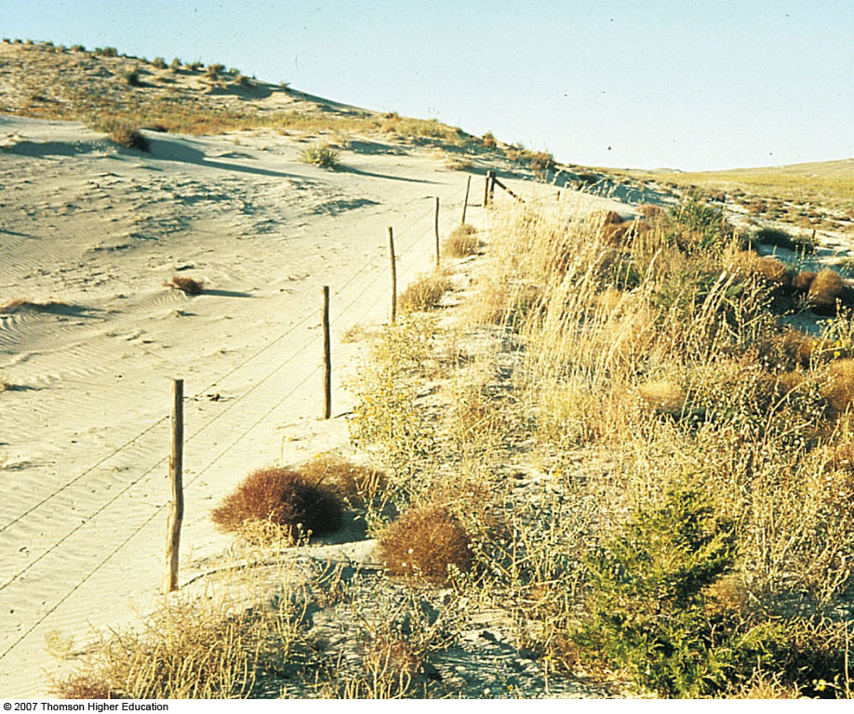
MANAGING AND SUSTAINING GRASSLANDS
Overgrazing (left) occurs when too many animals graze for too long and exceed carrying capacity of a grassland area.
Figure 10-21

Slide 17
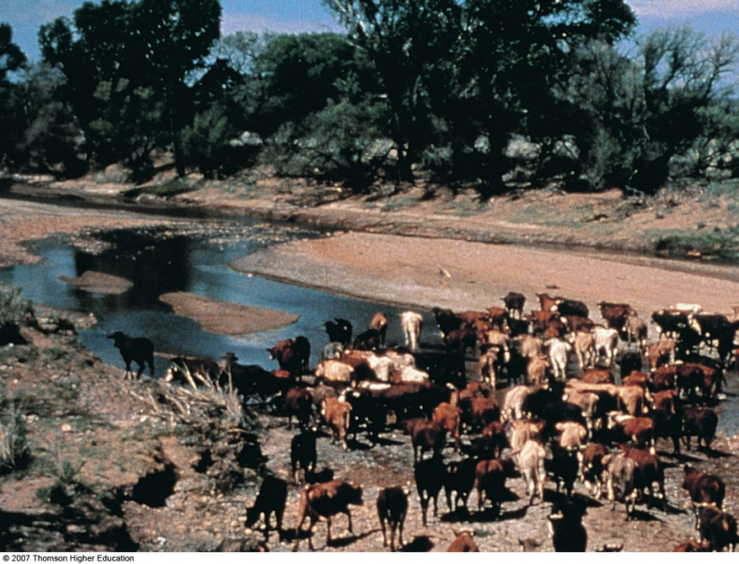
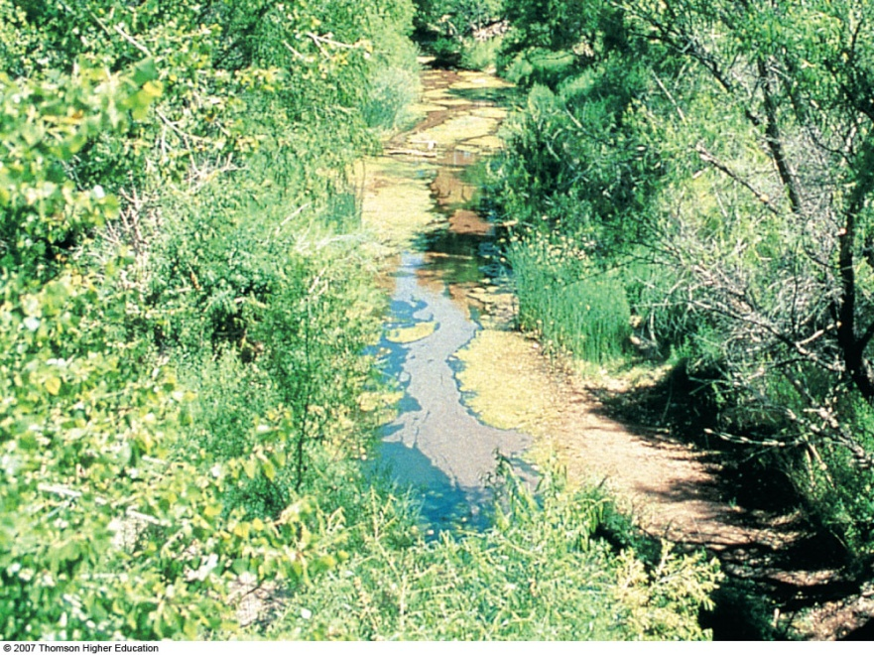
MANAGING AND SUSTAINING GRASSLANDS
Example of restored area along the San Pedro River in Arizona after 10 years of banning grazing and off-road vehicles.
Figure 10-22

Slide 18
Case Study: Grazing and Urban Development in the American West
Ranchers, ecologists, and environmentalists are joining together to preserve the grasslands on cattle ranches.
Paying ranchers conservation easements (barring future owners from development).
Pressuring government to zone the land to prevent development of ecologically sensitive areas.

Slide 19
NATIONAL PARKS
Countries have established more than 1,100 national parks, but most are threatened by human activities.
Local people invade park for wood, cropland, and other natural resources.
Loggers, miners, and wildlife poachers also deplete natural resources.
Many are too small to sustain large-animal species.
Many suffer from invasive species.

Slide 20
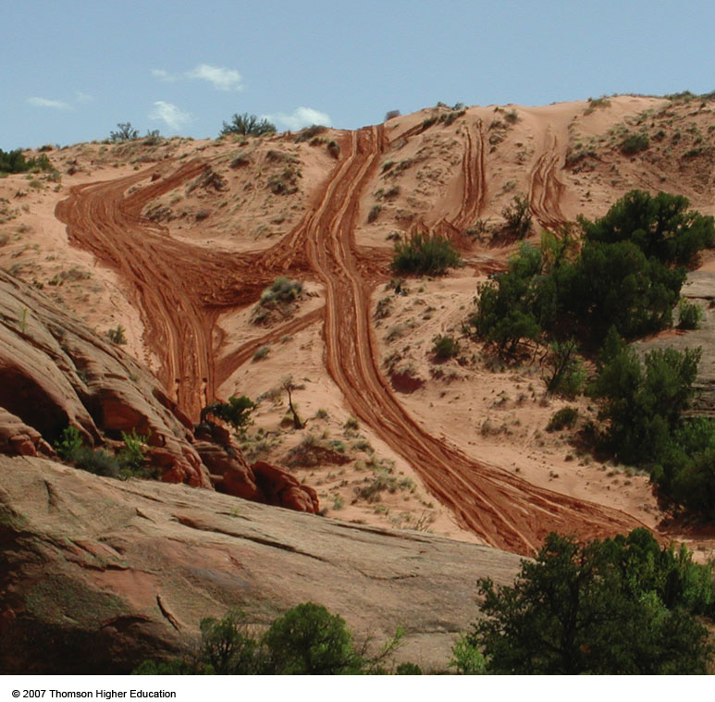
Case Study: Stresses on U.S. National Parks
Overused due to popularity.
Inholdings (private ownership) within parks threaten natural resources.
Air pollution.
Figure 10-23

Slide 21
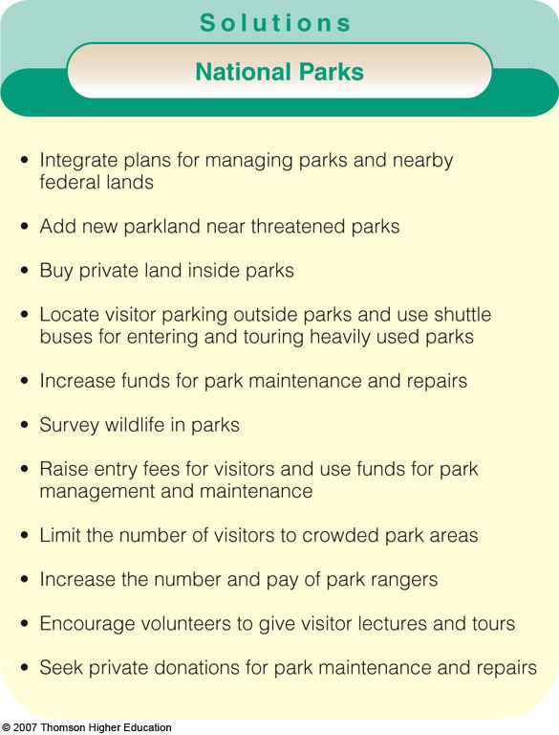
Suggestions for sustaining and expanding the national park system in the U.S.
Figure 10-24

Slide 22
Solutions
National Parks
• Integrate plans for managing parks and nearby federal lands
• Add new parkland near threatened parks
• Buy private land inside parks
• Locate visitor parking outside parks and use shuttle buses for entering and touring heavily used parks
• Increase funds for park maintenance and repairs
• Survey wildlife in parks
• Raise entry fees for visitors and use funds for park management and maintenance
• Limit the number of visitors to crowded park areas
• Increase the number and pay of park rangers
• Encourage volunteers to give visitor lectures and tours
• Seek private donations for park maintenance and repairs
Fig. 10-24, p. 211
Notes:
Figure 10.24
Solutions: suggestions for sustaining and expanding the national park system in the United States. QUESTION: Which two of these solutions do you think are the most important? (Data from Wilderness Society and National Parks and Conservation Association)

Slide 23
NATURE RESERVES
Ecologists call for protecting more land to help sustain biodiversity, but powerful economic and political interests oppose doing this.
Currently 12% of earth’s land area is protected.
Only 5% is strictly protected from harmful human activities.
Conservation biologists call for full protection of at least 20% of earth’s land area representing multiple examples of all biomes.

Slide 24
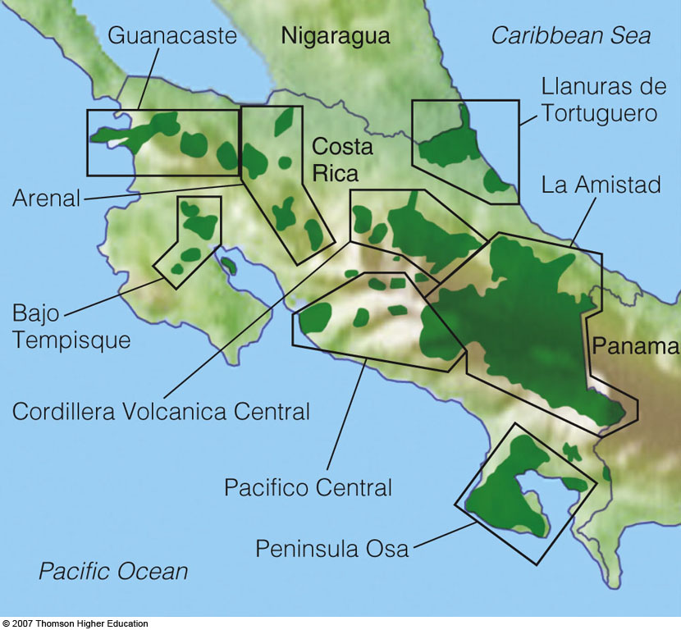
NATURE RESERVES
Large and medium-sized reserves with buffer zones help protect biodiversity and can be connected by corridors.
Costa Rica has consolidated its parks and reserves into 8 megareserves designed to sustain 80% if its biodiversity.
Figure 10-10B

Slide 25
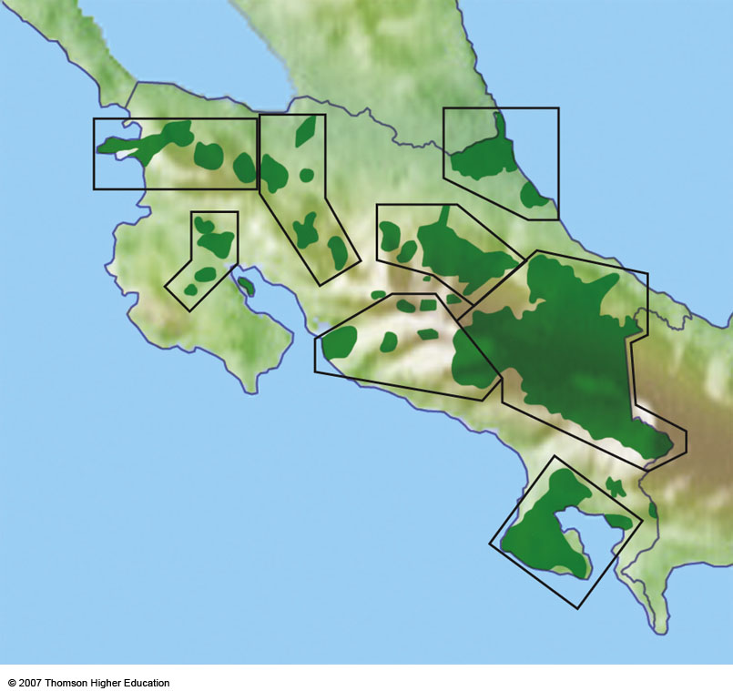
Guanacaste
Nigaragua
Caribbean Sea
Llanuras de
Tortuguero
Costa
Rica
La Amistad
Arenal
Bajo
Tempisque
Panama
Cordillera Volcanica Central
Pacifico Central
Peninsula Osa
Pacific Ocean
Fig. 10-B, p. 213
Notes:
Figure 10.B
Solutions: Costa Rica has consolidated its parks and reserves into eight megareserves designed to sustain about 80% of the country’s rich biodiversity.

Slide 26
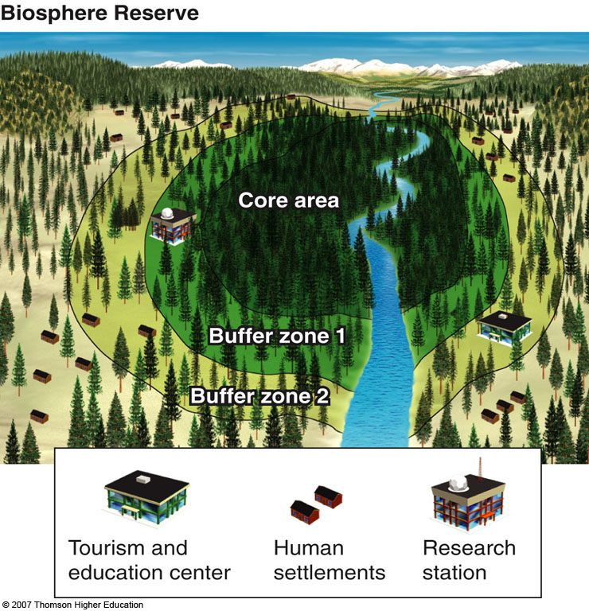
NATURE RESERVES
A model biosphere reserve that contains a protected inner core surrounded by two buffer zones that people can use for multiple use.
Figure 10-25

Slide 27
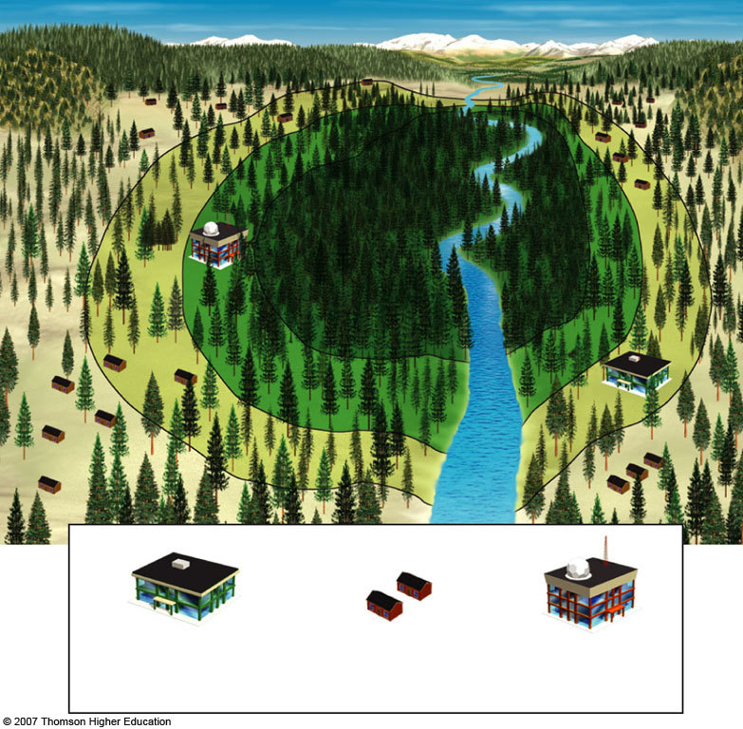
Biosphere Reserve
Core area
Buffer zone 1
Buffer zone 2
Tourism and
education center
Human
Settlements
Research
Station
Fig. 10-25, p. 214
Notes:
Figure 10.25
Solutions: a model biosphere reserve. Each reserve contains a protected inner core surrounded by two buffer zones that local and indigenous people can use for sustainable logging, food growing, cattle grazing, hunting, fishing, and ecotourism.

Slide 28
NATURE RESERVES
Geographic Information System (GIS) mapping can be used to understand and manage ecosystems.
Identify areas to establish and connect nature reserves in large ecoregions to prevent fragmentation.
Developers can use GIS to design housing developments with the least environmental impact.

Slide 29
NATURE RESERVES
We can prevent or slow down losses of biodiversity by concentrating efforts on protecting global hot spots where significant biodiversity is under immediate threat.
Conservation biologists are helping people in communities find ways to sustain local biodiversity while providing local economic income.

Slide 30
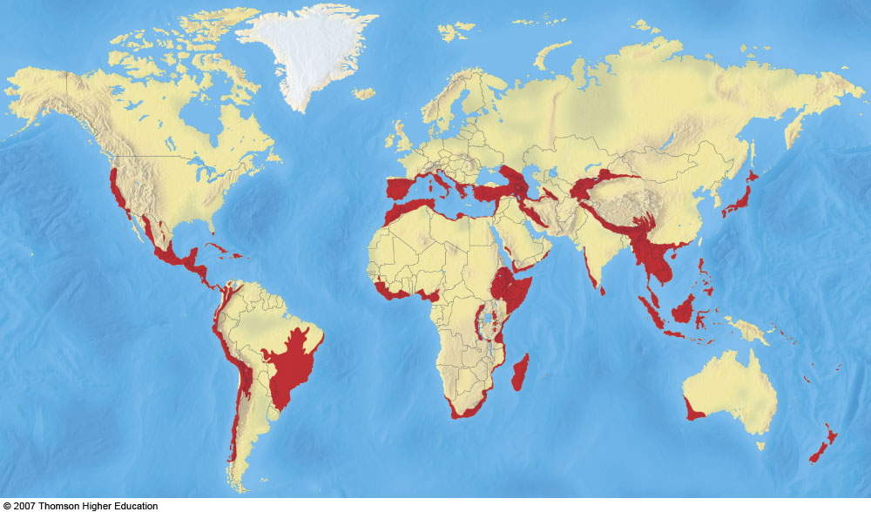
34 hotspots identified by ecologists as important and endangered centers of biodiversity.
Figure 10-26

Slide 31
NATURE RESERVES
Wilderness is land legally set aside in a large enough area to prevent or minimize harm from human activities.
Only a small percentage of the land area of the United States has been protected as wilderness.

Slide 32
ECOLOGICAL RESTORATION
Restoration: trying to return to a condition as similar as possible to original state.
Rehabilitation: attempting to turn a degraded ecosystem back to being functional.
Replacement: replacing a degraded ecosystem with another type of ecosystem.
Creating artificial ecosystems: such as artificial wetlands for flood reduction and sewage treatment.

Slide 33
ECOLOGICAL RESTORATION
Five basic science-based principles for ecological restoration:
Identify cause.
Stop abuse by eliminating or sharply reducing factors.
Reintroduce species if necessary.
Protect area form further degradation.
Use adaptive management to monitor efforts, assess successes, and modify strategies.

Slide 34
Will Restoration Encourage Further Destruction?
There is some concern that ecological restoration could promote further environmental destruction and degradation.
Suggesting that any ecological harm can be undone.
Preventing ecosystem damage is far cheaper than ecological restoration.

Slide 35
WHAT CAN WE DO?
Eight priorities for protecting biodiversity:
Take immediate action to preserve world’s biological hot spots.
Keep intact remaining old growth.
Complete mapping of world’s biodiversity for inventory and decision making.
Determine world’s marine hot spots.
Concentrate on protecting and restoring lake and river systems (most threatened ecosystems).

Slide 36
WHAT CAN WE DO?
Ensure that the full range of the earths ecosystems are included in global conservation strategy.
Make conservation profitable.
Initiate ecological restoration products to heal some of the damage done and increase share of earth’s land and water allotted to the rest of nature.

Slide 37
What Can You Do?
Sustaining Terrestrial Biodiversity
• Adopt a forest.
• Plant trees and take care of them.
• Recycle paper and buy recycled paper products.
• Buy sustainable wood and wood products.
• Choose wood substitutes such as bamboo furniture and recycled plastic outdoor furniture, decking, and fencing.
• Restore a nearby degraded forest or grassland.
• Landscape your yard with a diversity of plants natural to the area.
• Live in town because suburban sprawl reduces biodiversity.
Fig. 10-27, p. 219
Notes:
Figure 10.27
Individuals matter: ways to help sustain terrestrial biodiversity.

