Slide 1
Biogeochemical cycles

Slide 2
MATTER CYCLING IN ECOSYSTEMS
Nutrient Cycles: Global Recycling
Global Cycles recycle nutrients through the earth’s air, land, water, and living organisms.
Nutrients are the elements and compounds that organisms need to live, grow, and reproduce.
Biogeochemical cycles move these substances through air, water, soil, rock and living organisms.

Slide 3
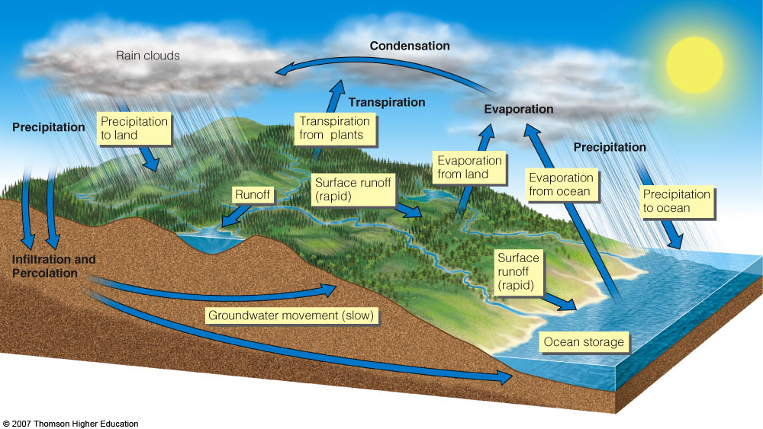
The Water Cycle
Figure 3-26

Slide 4
Water’ Unique Properties
There are strong forces of attraction between molecules of water.
Water exists as a liquid over a wide temperature range.
Liquid water changes temperature slowly.
It takes a large amount of energy for water to evaporate.
Liquid water can dissolve a variety of compounds.
Water expands when it freezes.

Slide 5
Effects of Human Activities on Water Cycle
We alter the water cycle by:
Withdrawing large amounts of freshwater.
Clearing vegetation and eroding soils.
Polluting surface and underground water.
Contributing to climate change.

Slide 6
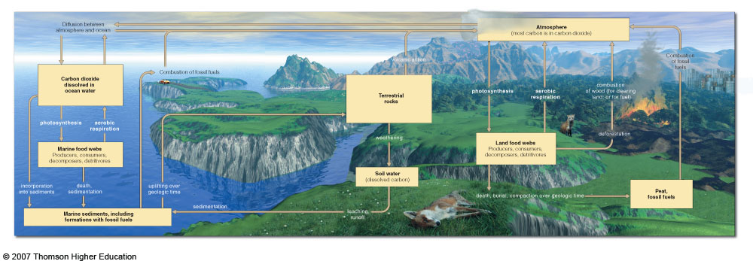
The Carbon Cycle: Part of Nature’s Thermostat
Figure 3-27

Slide 7
Fig. 3-27, pp. 72-73
Notes:
Figure 3.27
Natural capital: simplified model of the global carbon cycle. Carbon moves through both marine ecosystems (left side) and terrestrial ecosystems (right side). Carbon reservoirs are shown as boxes; processes that change one form of carbon to another are shown in unboxed print. QUESTION: What are three ways in which your lifestyle directly or indirectly affects the carbon cycle? (From Cecie Starr, Biology: Concepts and Applications, 4th ed., Pacific Grove, Calif.: Brooks/Cole, © 2000)

Slide 8
Where is carbon stored?
#1: sedimentary rock
#2: the oceans
The largest storage reservoir for the earth’s carbon is sedimentary rock such as limestone (CaCO3)
The second largest storage reservoir for carbon dioxide. CO2 gas is soluble in water. As water warms, more CO2 is released to atmosphere.

Slide 9
What percent of our atmosphere is composed of carbon dioxide?
about 0.4%! AND..most comes from natural sources!
So, why all the fuss?
Carbon dioxide is a key component of nature’s thermostat. Even slight changes in the carbon cycle can affect climate.

Slide 10
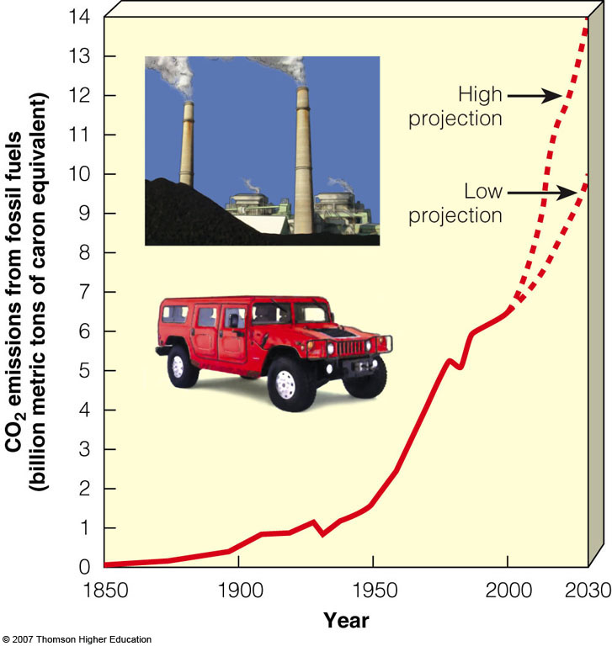
Effects of Human Activities on Carbon Cycle
We alter the carbon cycle by adding excess CO₂ to the atmosphere through:
Burning fossil fuels.
Clearing vegetation faster than it is replaced.
Figure 3-28

Slide 11
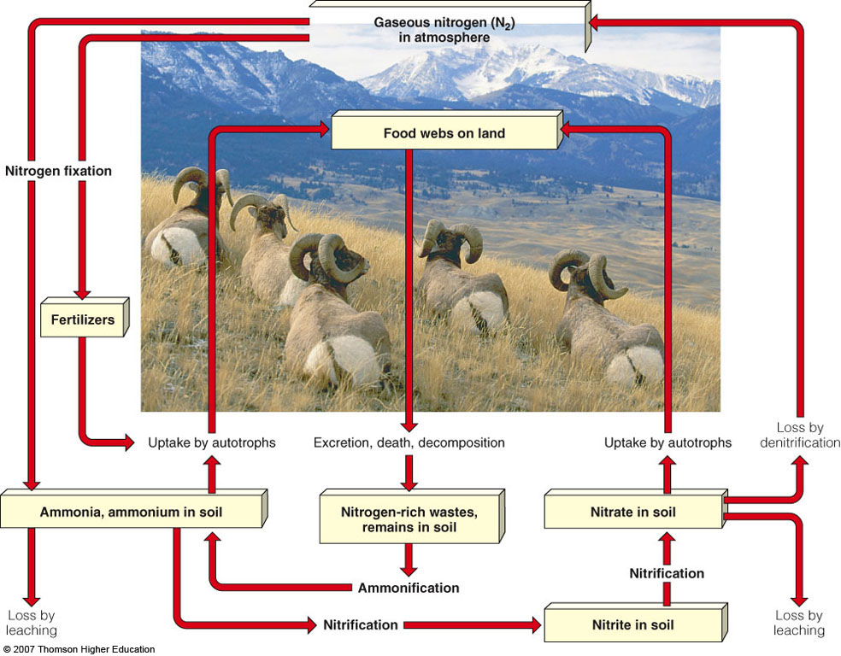
The Nitrogen Cycle: Bacteria in Action
Figure 3-29

Slide 12
How is nitrogen cycled in the atmosphere?
Organisms use nitrogen to make amino acids, proteins, DNA, and RNA.
Nitrogen is an essential plant nutrient.
N2 (gas) cannot be absorbed and used directly as a nutrient. Must be “fixed”, that is , combined with hydrogen or oxygen. This is done by lightning and bacteria in the soil and water.

Slide 13
Effects of Human Activities on the Nitrogen Cycle
We alter the nitrogen cycle by:
Adding gases that contribute to acid rain. (HNO3)
Adding nitrous oxide to the atmosphere through farming practices which can warm the atmosphere and deplete ozone.
Adding nitrogen compounds to aquatic ecosystems in agricultural runoff and discharge of sewage. This stimulates growth of algae leading to depletion of DO and accelerated eutrophication.
Releasing nitrogen into the troposphere through deforestation.
Over the last 100 years, human activities have doubled the amount of fixed nitrogen entering the nitrogen cycle.

Slide 14
Eutrophication
Physical,chemical,and biological changes that take place after a lake,estuary, or slow flowing stream receive inputs of plant nutrients-mostly nitrates and phosphates-from natural erosion and runoff from the surrounding land basin.
CULTURAL EUTROPHICATION: Overnourishment of aquatic ecosystems with plant nutrients ( nitrates and phosphates) because of hman activities such as agriculture, urbanization,and discharges from industrial plants and sewage treatment plants.

Slide 15
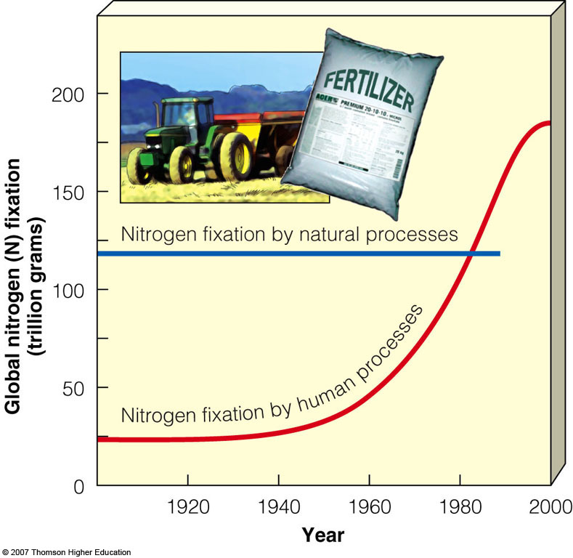
Effects of Human Activities on the Nitrogen Cycle
Human activities such as production of fertilizers now fix more nitrogen than all natural sources combined.
Figure 3-30

Slide 16
The Phosphorous Cycle
Figure 3-31

Slide 17
Cycling of Phosphorus
A sedimentary cycle, has no significant atmospheric phase.
Typically found as phosphate salts in terrestrial rock formations and ocean sediments.
Often the limiting factor for plant growth on land and water.

Slide 18
Effects of Human Activities on the Phosphorous Cycle
We remove large amounts of phosphate from the earth to make fertilizer.
We reduce phosphorous in tropical soils by clearing forests.
We add excess phosphates to aquatic systems from runoff of animal wastes and fertilizers.

Slide 19
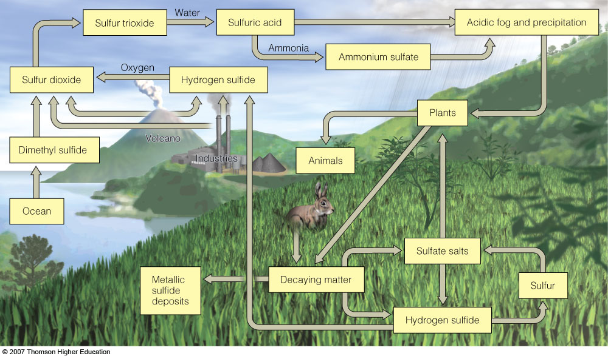
The Sulfur Cycle
Figure 3-32

Slide 20
Cycling of Sulfur
A gaseous cycle.
Much of earth’s sulfur is stored underground in rocks and minerals
Enters atmosphere from many natural sources: volcanoes, breakdown of organic matter in swamps, bogs, and tidal flats.
In atmosphere SO2 can combine with water to produce H2SO4; sulfuric acid. “Acid rain”

Slide 21
Effects of Human Activities on the Sulfur Cycle
We add sulfur dioxide to the atmosphere by:
Burning coal and oil
Refining sulfur -containing petroleum.
Convert sulfur-containing metallic ores into free metals such as copper, lead, and zinc releasing sulfur dioxide into the environment.

